Slide 1




Drew Fustini
drew@beagleboard.org
Twitter: @pdp7
Slides: https://github.com/pdp7/talks/blob/master/rv-elc.pdf
Linux on RISC-V
with open source hardware and open source FPGA tools
Embedded Linux Conference 2020

Slide 2
Open Source Hardware designer at OSH Park
(PCB manufacturing service in the USA)
drew@oshpark.com / Twitter: @oshpark
Board of Directors, BeagleBoard.org Foundation
drew@beagleboard.org
Board of Directors, Open Source Hardware Assoc.
Certification Program: https://certification.oshwa.org/
RISC-V Ambassador for RISC-V International
https://riscv.org/

Slide 3
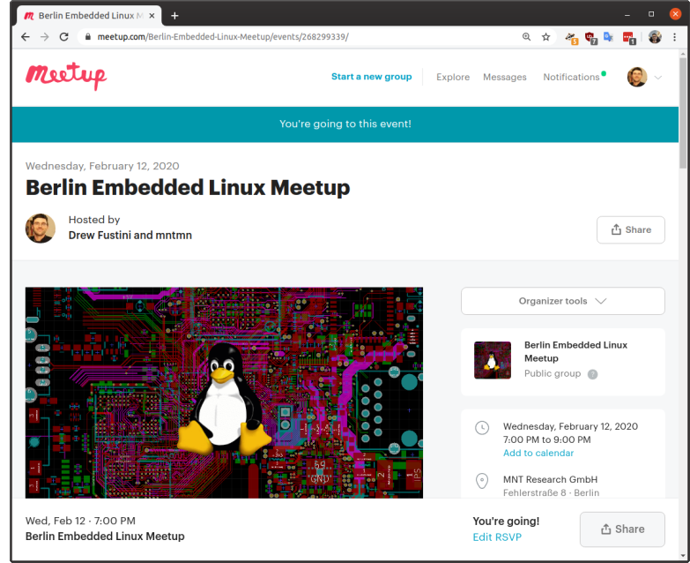

Slide 4


https://riscv.org/local/

Slide 5

Statement of Principles:
Hardware whose design is made publicly available so that anyone can study, modify, distribute, make, and sell the design or hardware based on that design

Slide 6

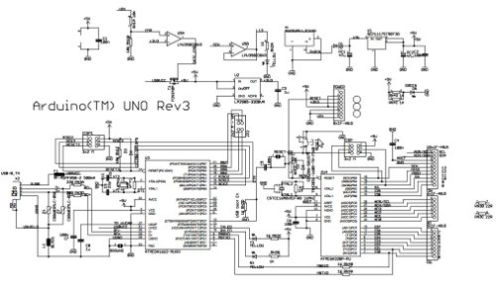
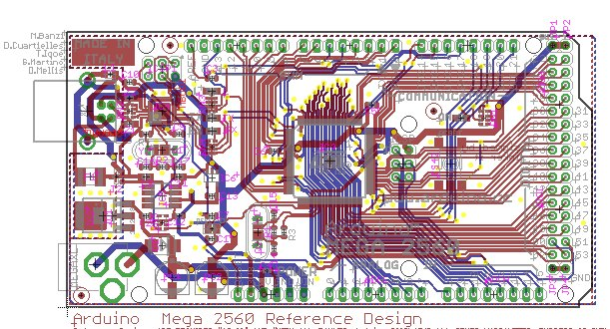
Documentation required for electronics:
Schematics Board Layout
Editable source files for CAD software such as KiCad or EAGLE
Bill of Materials (BoM)
Not strict requirement, but best practice is for all components available from distributors in low quantity

Slide 7
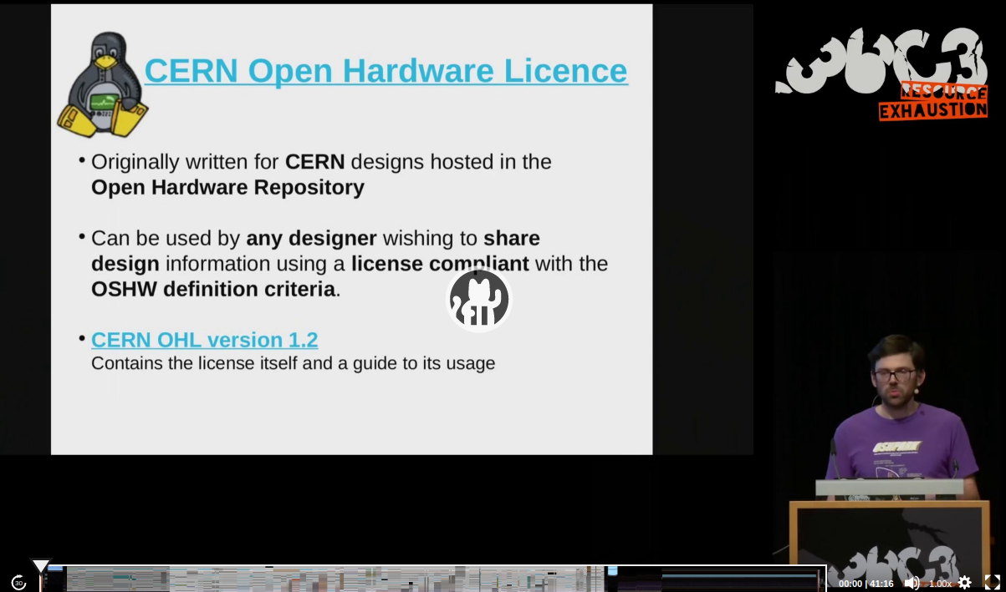
36c3 talk: Linux on Open Source Hardware with Open Source chip design

Slide 8
Slides: https://github.com/pdp7/talks/blob/master/rv-elc.pdf
Section: RISC-V the instruction set for everything?

Slide 9
When you write a C or C++ program, it is compiled into instructions for the microprocessor (CPU) to execute.
How does the compiler know what instructions the CPU understands?
defined by the Instruction Set Architecture
The ISA is a standard, a set of rules that define the tasks the processor can perform.
Examples: x86 (Intel/AMD) and ARM
Both are proprietary and need commercial licensing

Slide 10

RISC-V: Free and Open RISC Instruction Set Arch
“new instruction set architecture (ISA) that was originally designed to support computer architecture research and education and is now set to become a standard open architecture for industry”

Slide 11
RISC-V: Free and Open RISC Instruction Set Arch
Instruction Sets Want To Be Free: A Case for RISC-V
David Patterson, UC Berekely – co-creator of the original RISC!
https://www.youtube.com/watch?v=mD-njD2QKN0
RISC-V Summit 2019: State of the Union
Krste Asanovic, UC Berkeley
https://www.youtube.com/watch?v=jdkFi9_Hw-c

Slide 12
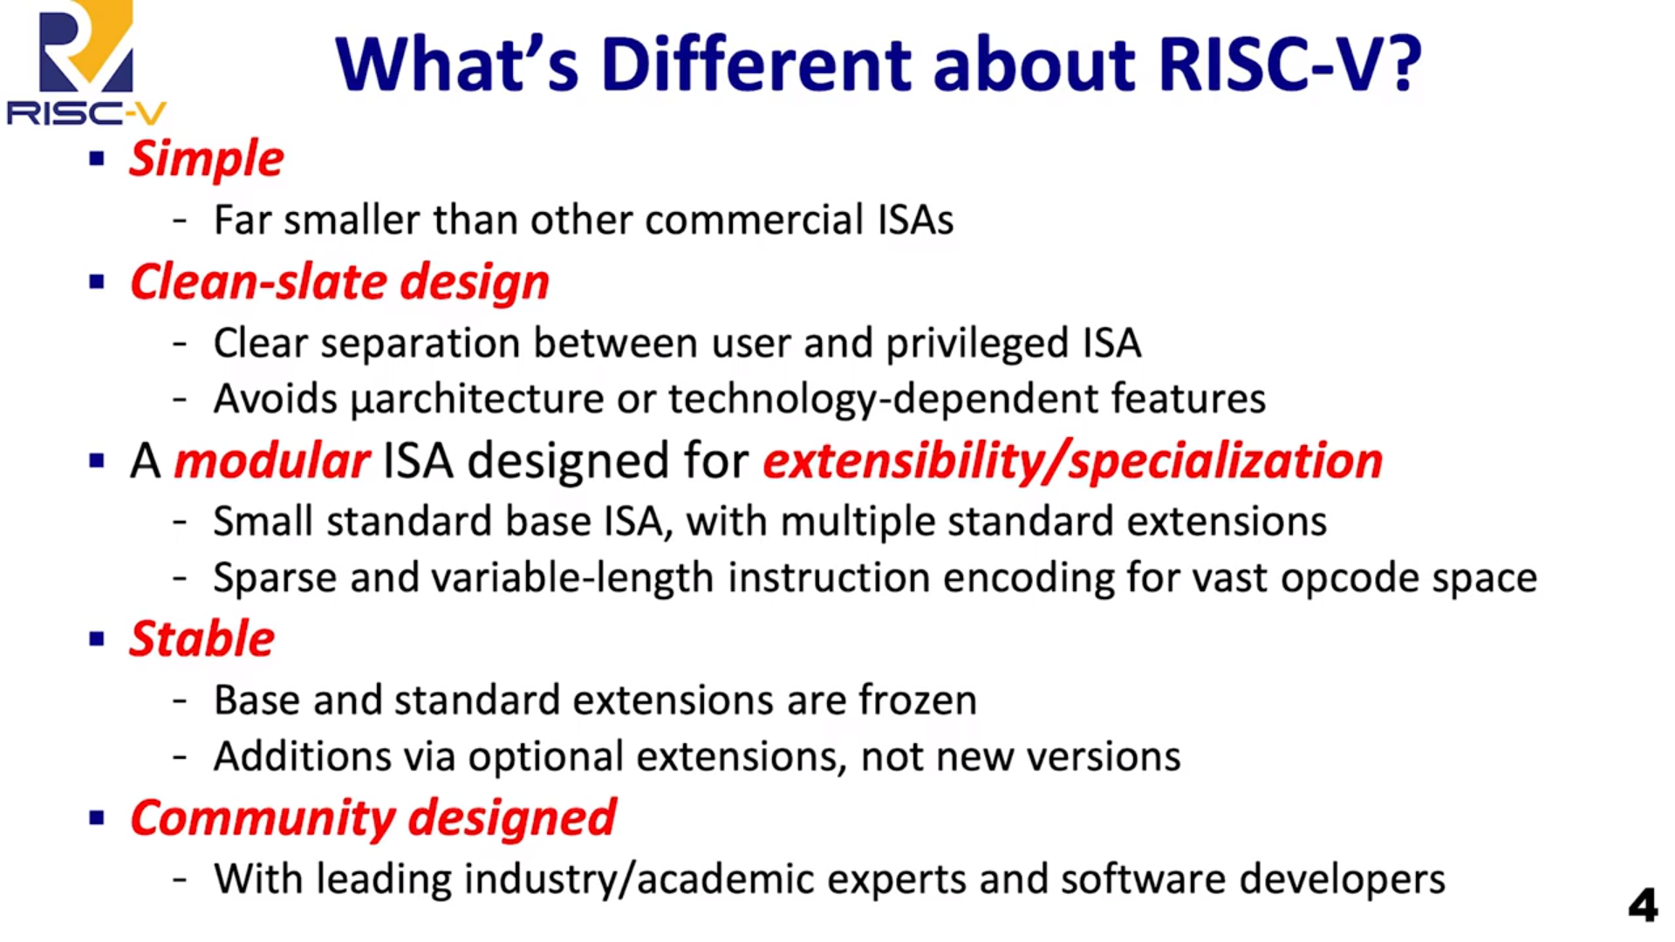

Slide 13
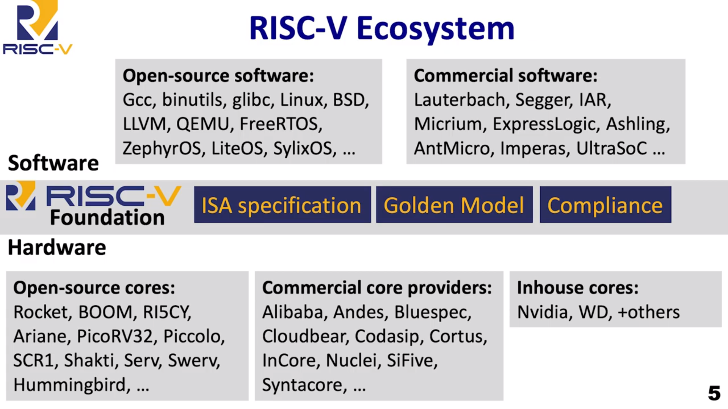

Slide 14
RISC-V and Industry
Designed to be extensible
Microcontroller to supercomputer
RISC-V Foundation now controls standard: riscv.org
Over 400 members: companies, universities and more
YouTube channel has hundreds of talks!
https://www.youtube.com/channel/UC5gLmcFuvdGbajs4VL-WU3g
Companies like Nvidia and Western Digital will ship millions of devices with RISC-V
Avoid ARM licensing fees
Freedom to leverage open source implementations
BOOM, Rocket, PULP, SweRV, and many more

Slide 15

lowRISC is a not-for-profit organisation whose goal is to produce a fully open source System-on-Chip (SoC) in volume
“We will produce a SoC design to populate a low-cost community development board and to act as an ideal starting point for derivative open-source and commercial designs”
OpenTitan project with Google
Announcing OpenTitan, the First Transparent Silicon Root of Trust

Slide 16
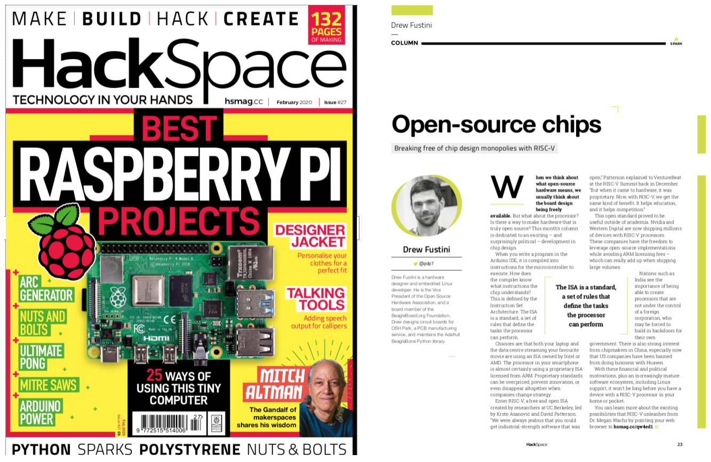
My column in the Hackspace Magazine is an introduction to RISC-V and how it is enabling open source chip design:
hackspace.raspberrypi.org/issues/27/

Slide 17
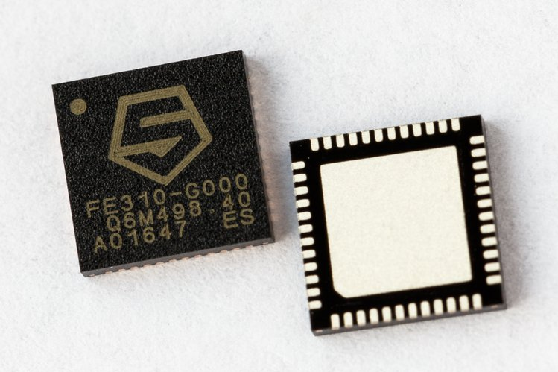
SiFive
“founded by the creators of the free and open RISC-V architecture as a reaction to the end of conventional transistor scaling and escalating chip design costs”

Slide 18
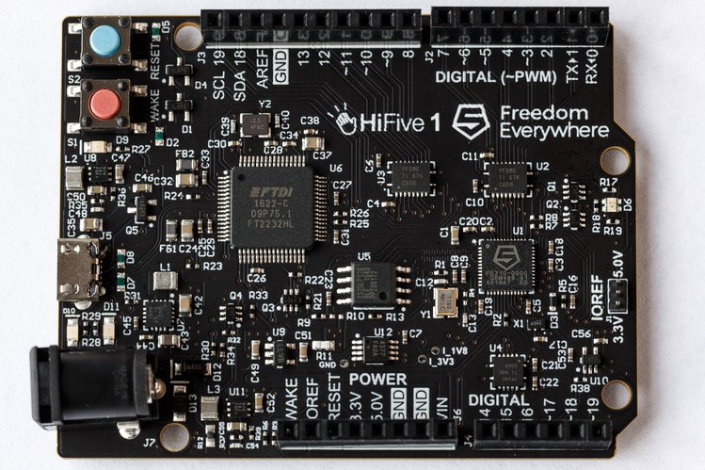
SiFive FE310 microcontroller
HiFive1: Arduino-Compatible RISC-V Dev Kit

Slide 19
Slides: https://github.com/pdp7/talks/blob/master/rv-elc.pdf
Section: Linux-capable RISC-V chips

Slide 20
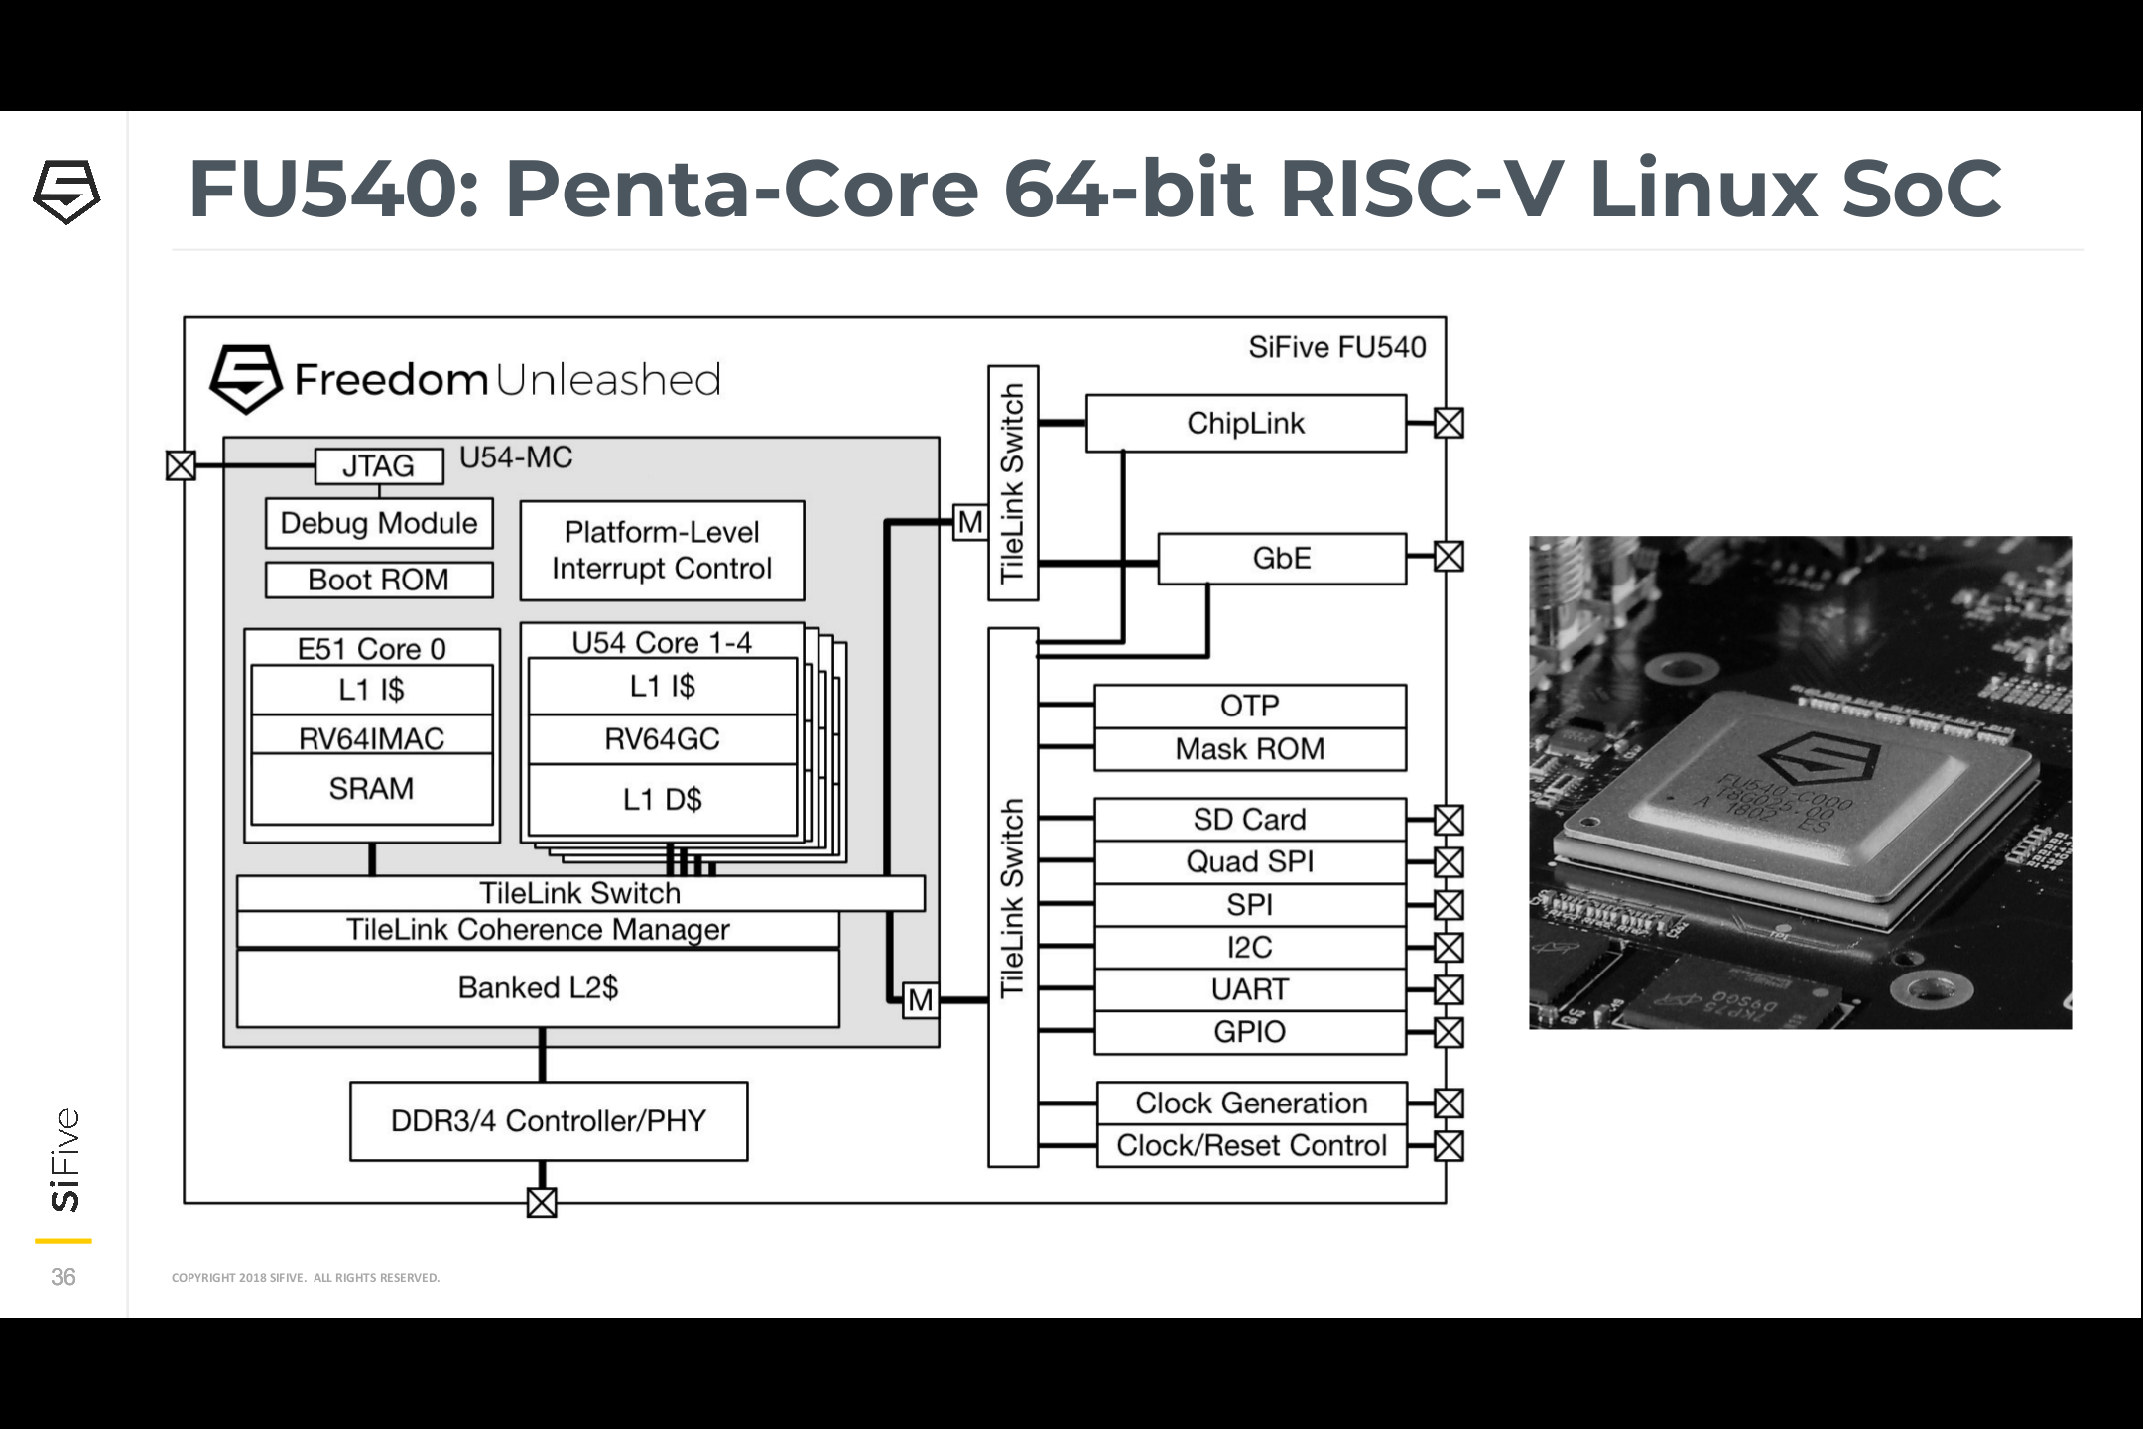
SiFive: Linux on RISC-V
FOSDEM 2018 talk
YouTube: “Igniting the Open Hardware Ecosystem with RISC-V: SiFive's Freedom U500 is the World's First Linux-capable Open Source SoC Platform”
Interview with Palmer Dabbelt of SiFive

Slide 21
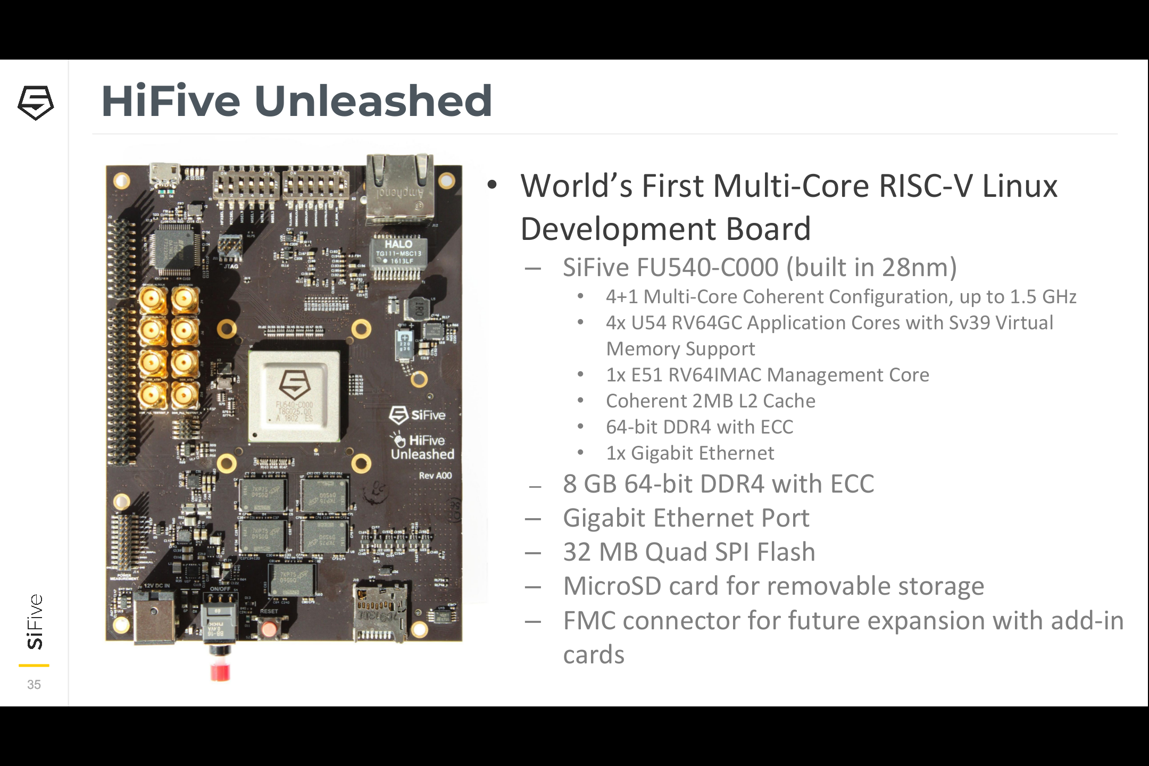
SiFive: Linux on RISC-V
HiFive Unleashed on Crowd Supply

Slide 22
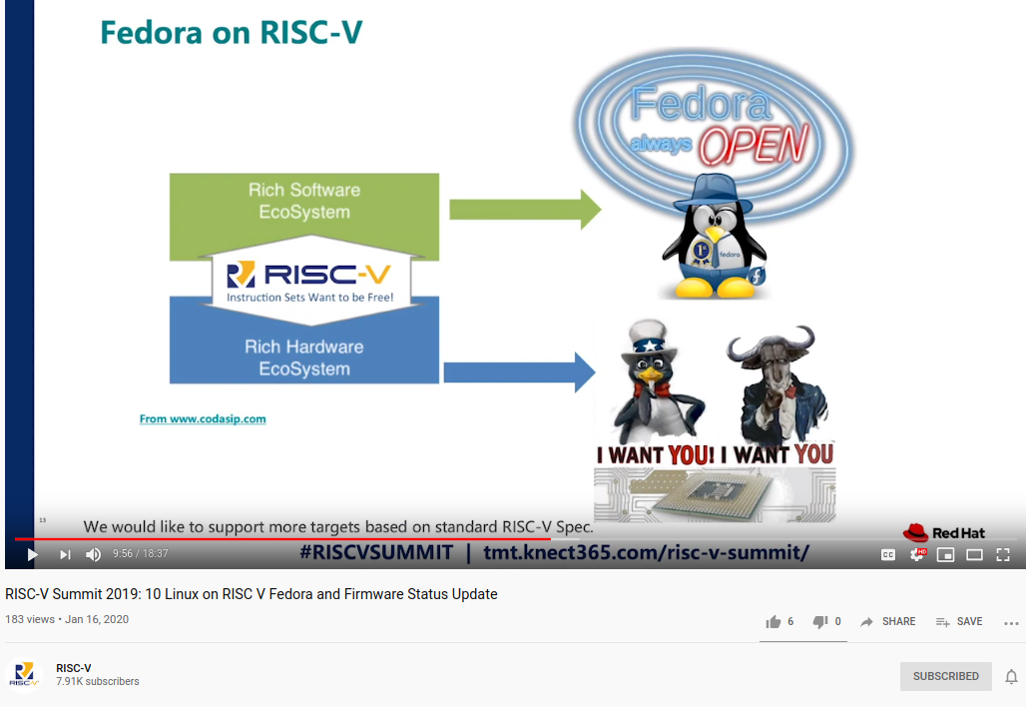
RISC-V Summit 2019: Linux on RISC V Fedora and Firmware Status Update
https://www.youtube.com/watch?v=WC6e3g8uWdk
Wei Fu – Software Engineer, Red Hat

Slide 23
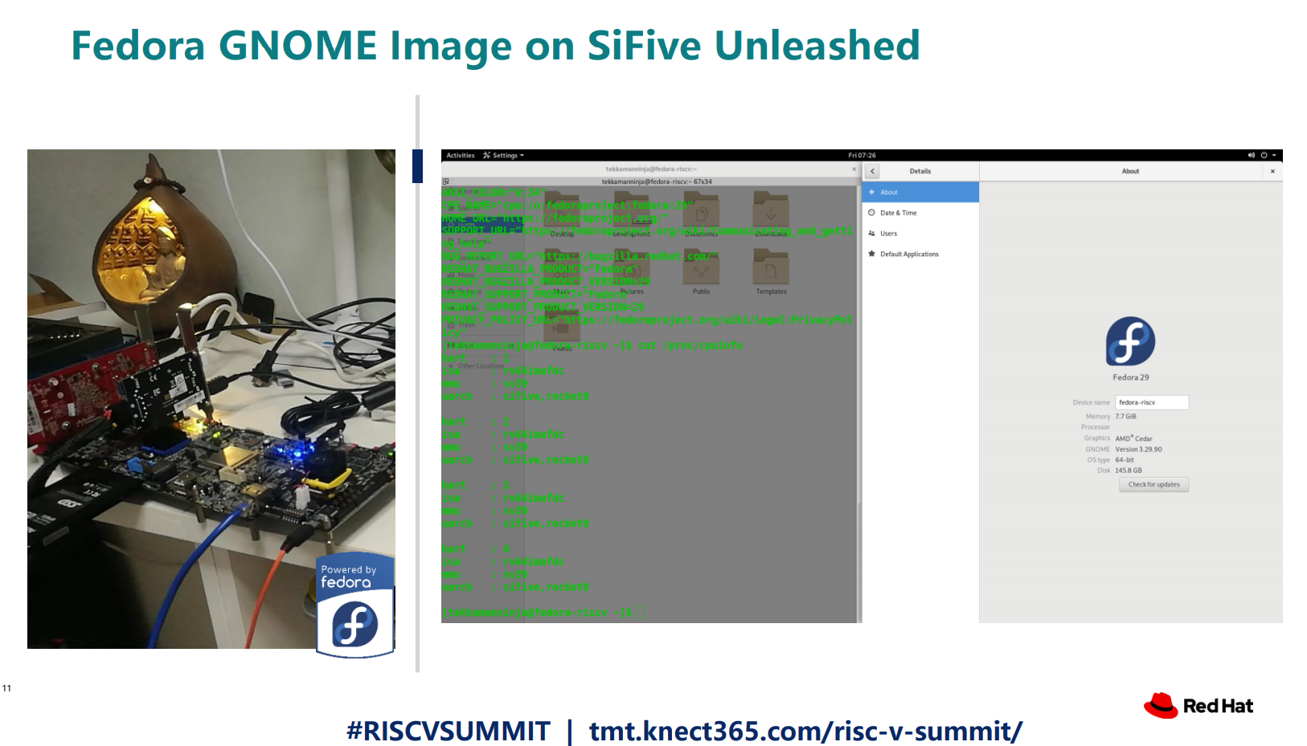

Slide 24
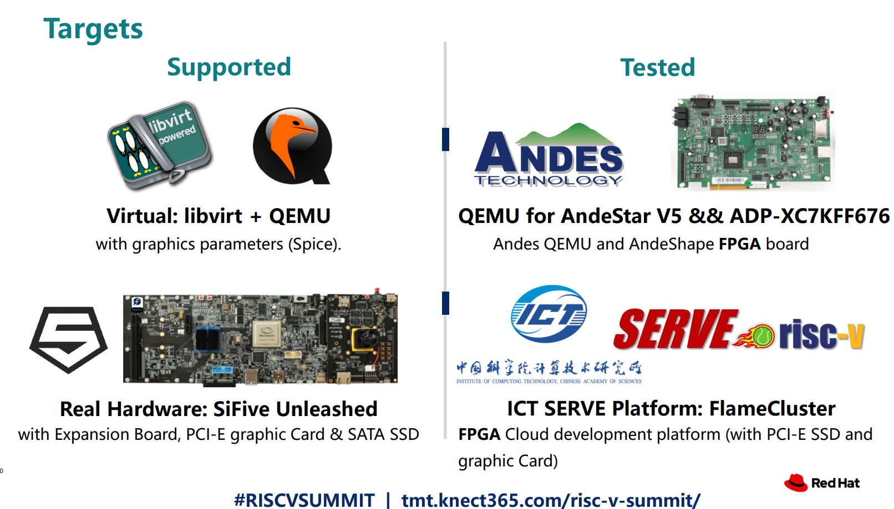

Slide 25
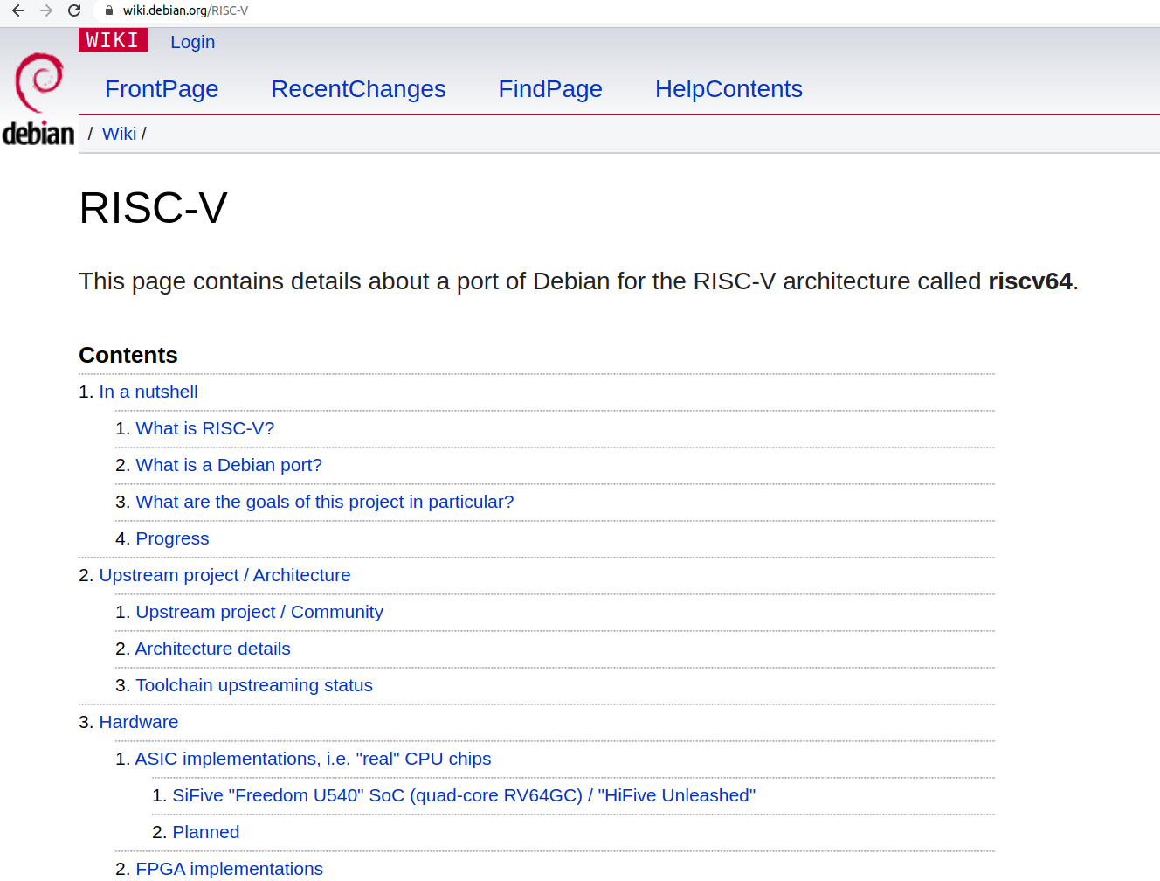

Slide 26
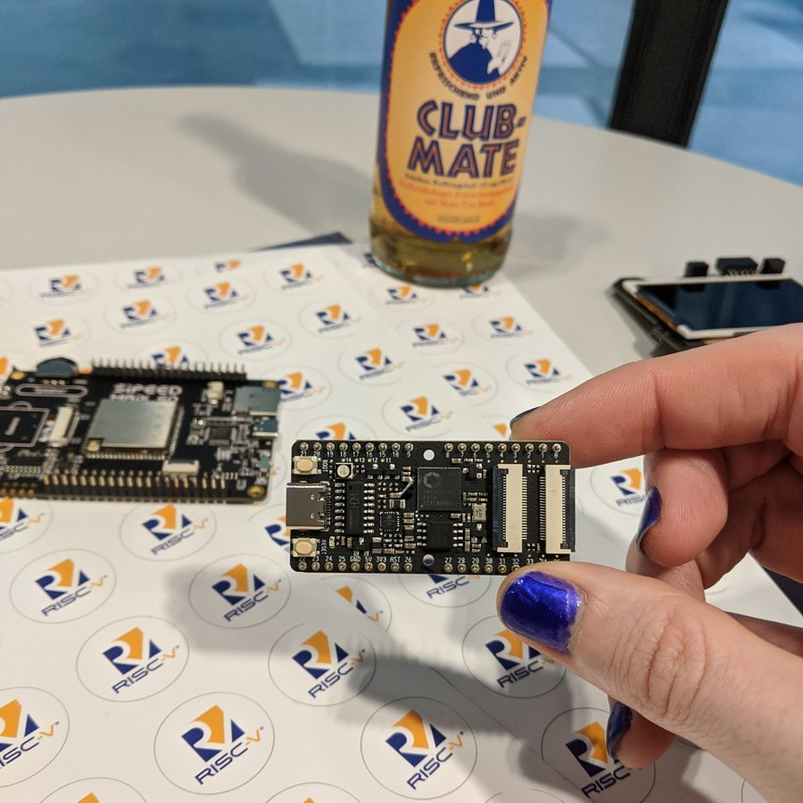

Slide 27
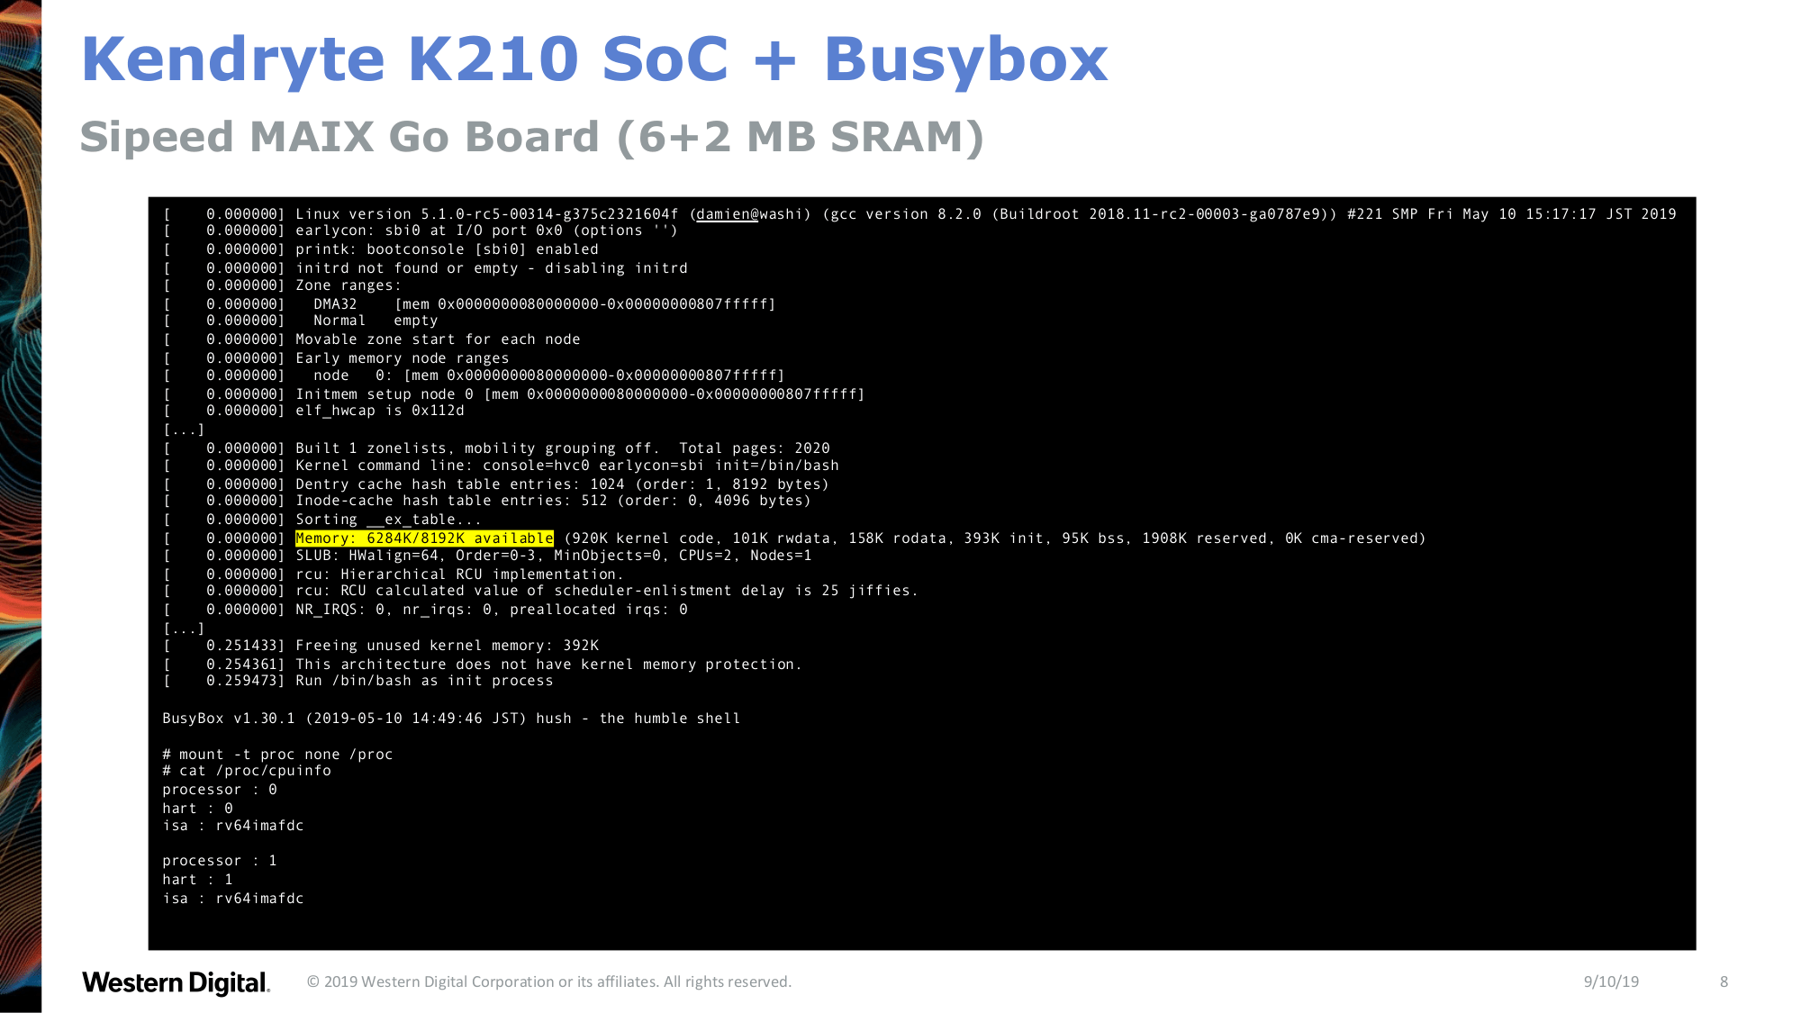

Slide 28
Linux now runs the low cost Kendryte K210 RISC-V processor
dual core 64-bit RISC-V at 400MHz with 8MB SRAM
Sipeed MAix BiT for RISC-V is only $13!
Damien Le Moal at Linux Plumbers Conf: RISC-V NOMMU and M-mode Linux
youtube.com/watch?v=ycG592N9EMA&t=10394
jump to 2h 53m
Many RISC-V Improvements Ready For Linux 5.5: M-Mode, SECCOMP, Other Features
How to Build & Run Linux on Kendryte K210 RISC-V NOMMU Processor

Slide 29
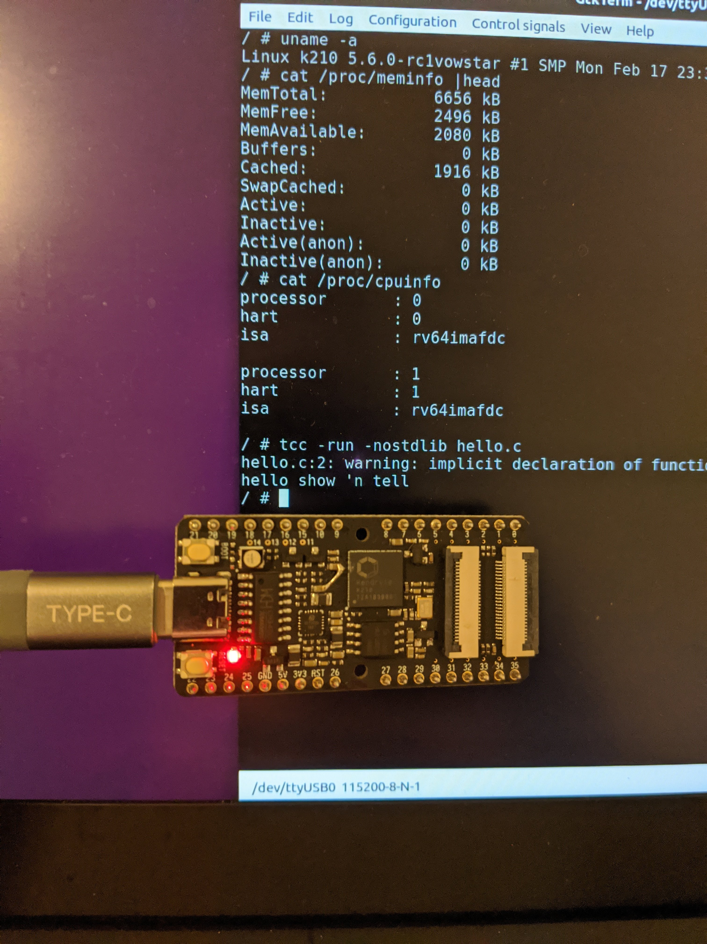

Slide 30
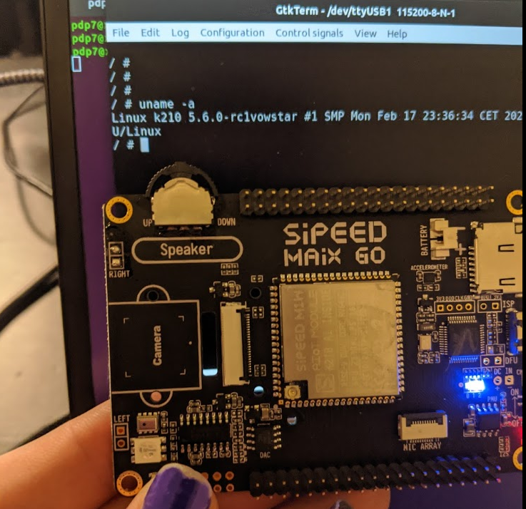

Slide 31
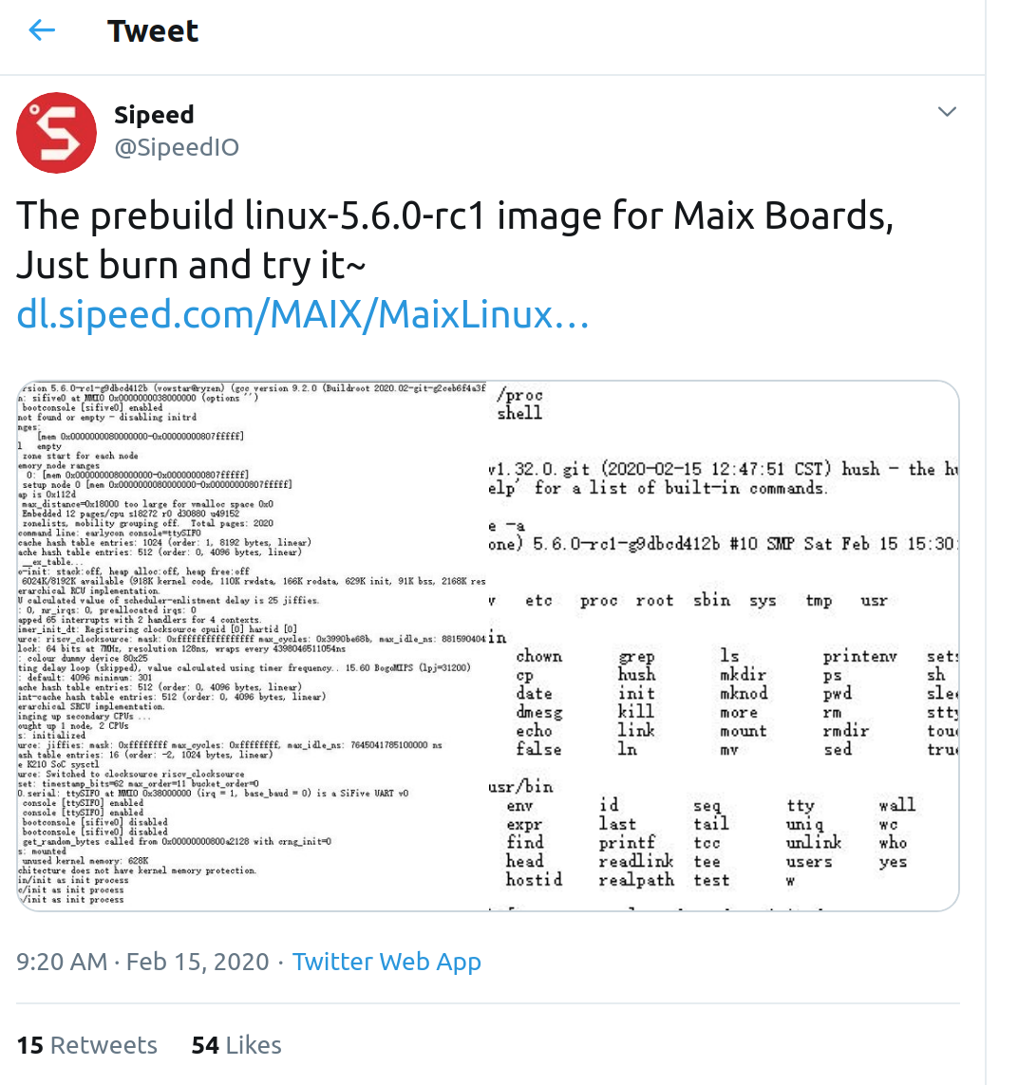
Sipeed now has prebuilt Linux 5.6
https://twitter.com/SipeedIO/status/1228594799675990016/

Slide 32
Coming in 2020
Microchip PolarFire SoC FPGA
Hard RISC-V with FPGA fabric… like the Xilinx Zync for ARM
OpenHW Core-V SoC which is similar to NXP iMX with RISC-V instead of ARM!
“OpenHW Group Unveils CORE-V Chassis SoC Project, Building on PULP Project IP”

Slide 33
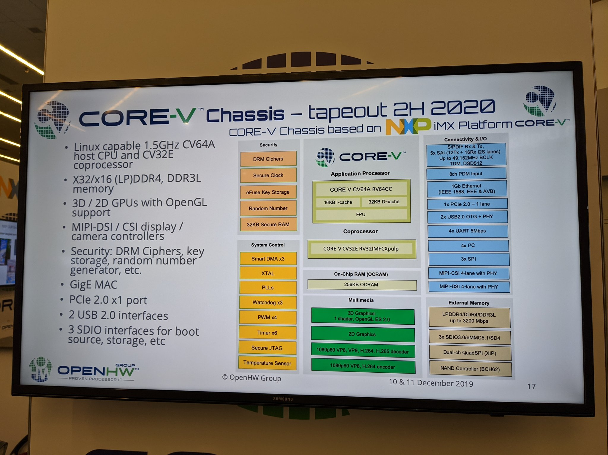
Coming in 2020?

Slide 34
Section: Open Source FPGA tools

Slide 35
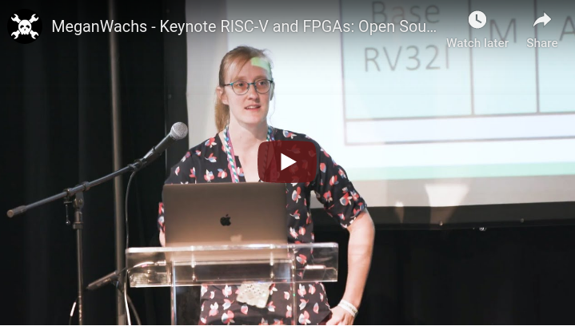
Keynote at Hackday Supercon 2019 by Dr. Megan Wachs of SiFive
“RISC-V and FPGAs: Open Source Hardware Hacking”
https://www.youtube.com/watch?v=vCG5_nxm2G4

Slide 36
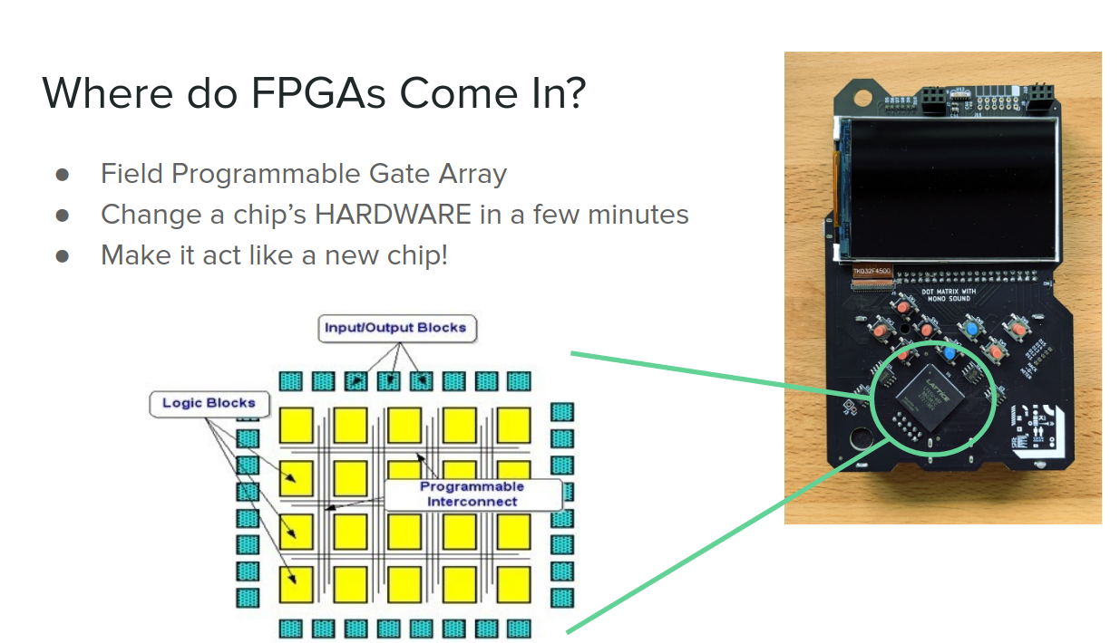

Slide 37
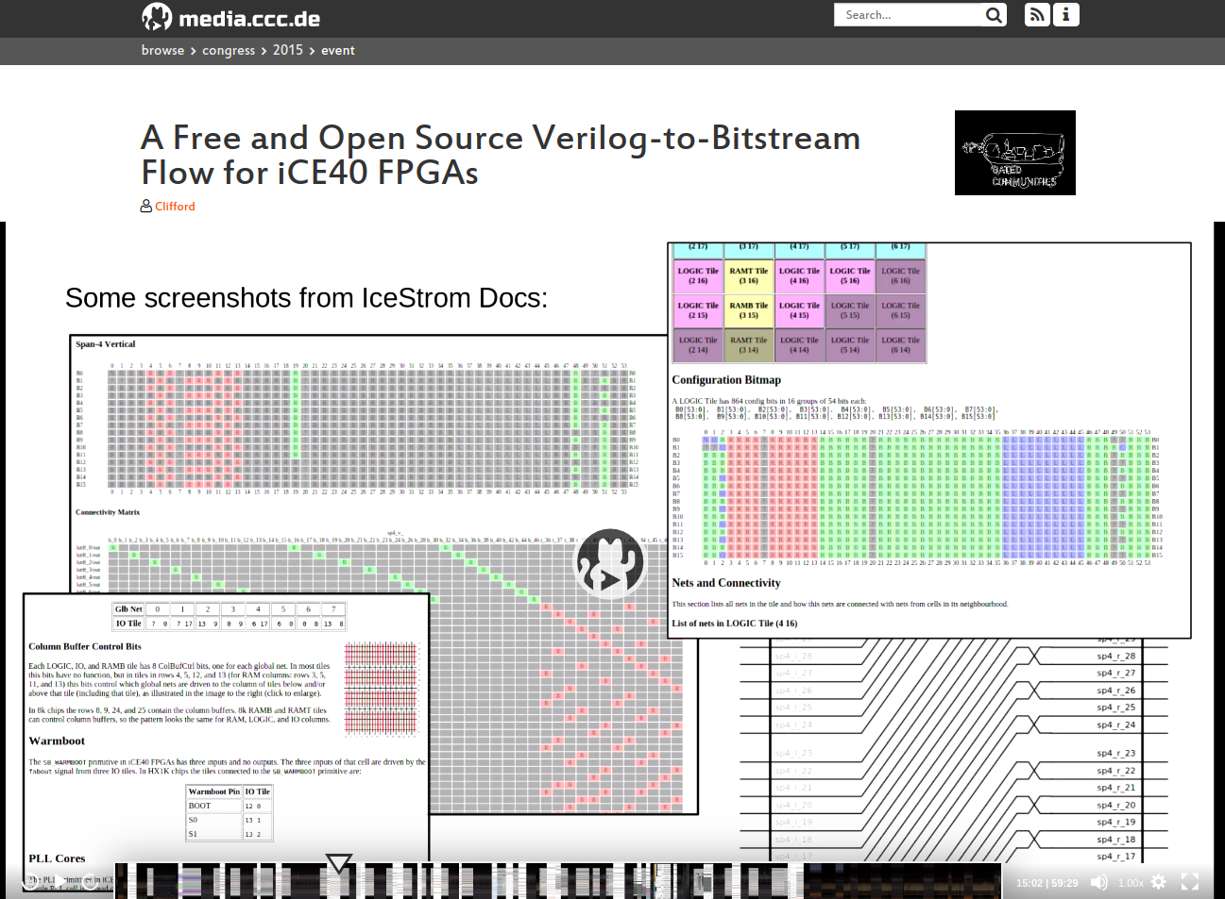
Open Source toolchains for FPGAs
Project IceStorm for Lattice iCE40
“A Free and Open Source Verilog-to-Bitstream Flow for iCE40 FPGAs” by Claire Wolf (oe1cxw) at 32c3

Slide 38
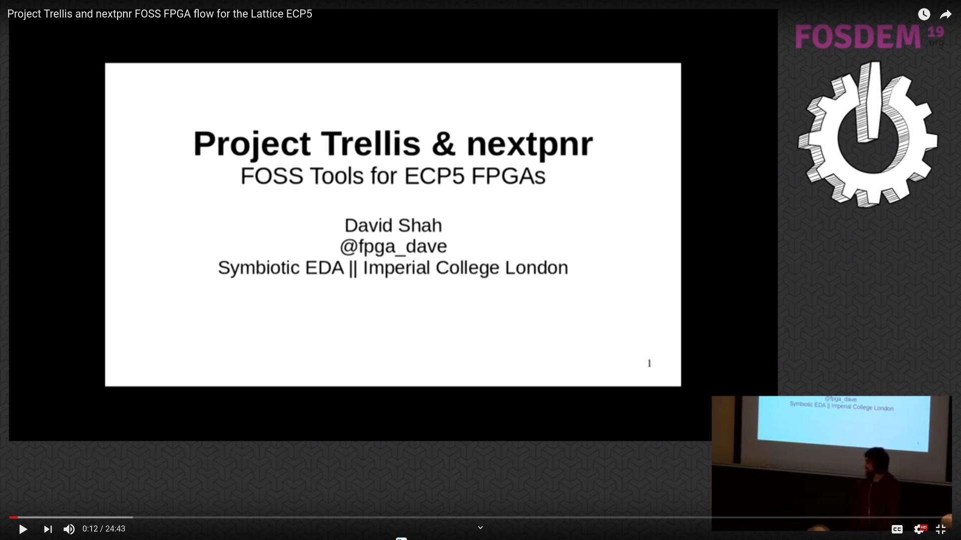
Open Source toolchains for FPGAs
Project Trellis for Lattice ECP5
“Project Trellis and nextpnr FOSS FPGA flow for the Lattice ECP5” - David Shah (@fpga_dave)
youtube.com/watch?v=0se7kNes3EU

Slide 39
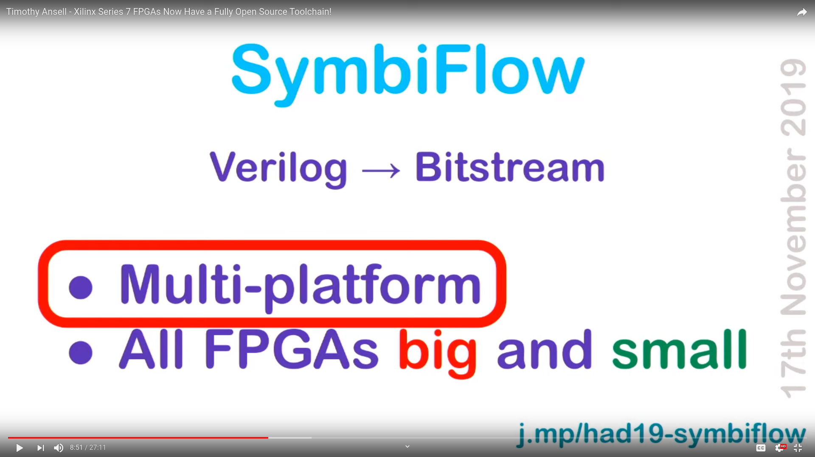
Open Source toolchains for FPGAs
Project X-Ray & SymbiFlow for Xilinix Series 7
Timothy ‘mithro’ Ansell: “Xilinx Series 7 FPGAs Now Have a Fully Open Source Toolchain!” (almost)
youtube.com/watch?v=EHePto95qoE

Slide 40
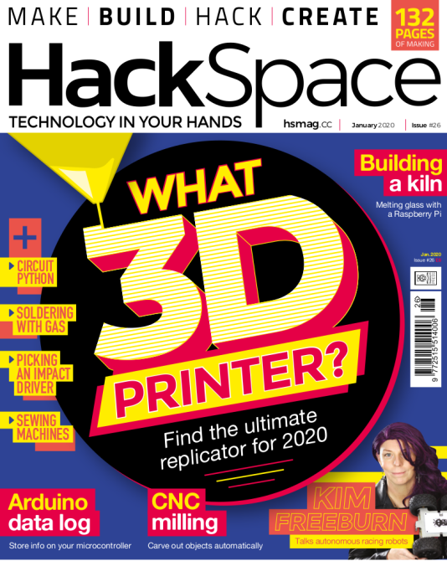
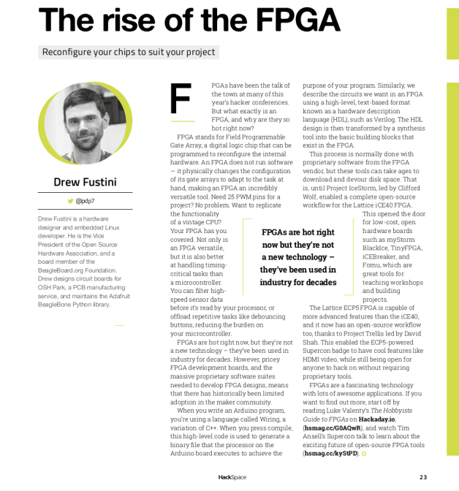
Open Source and FPGAs
Hackspace Magazine column about how about open source FPGA tools developed by Claire Wolf (oe1cxw), David Shah and others have made FPGAs more accessible than ever before to makers and hackers:
hackspace.raspberrypi.org/issues/26/

Slide 41
Slides: https://github.com/pdp7/talks/blob/master/rv-elc.pdf
Section: Linux on the Hackaday Badge

Slide 42
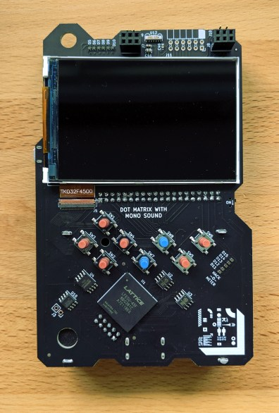
Hackaday 2019 Supercon badge
RISC-V “soft” core on ECP5 FPGA
Gigantic FPGA In A Game Boy Form Factor

Slide 43
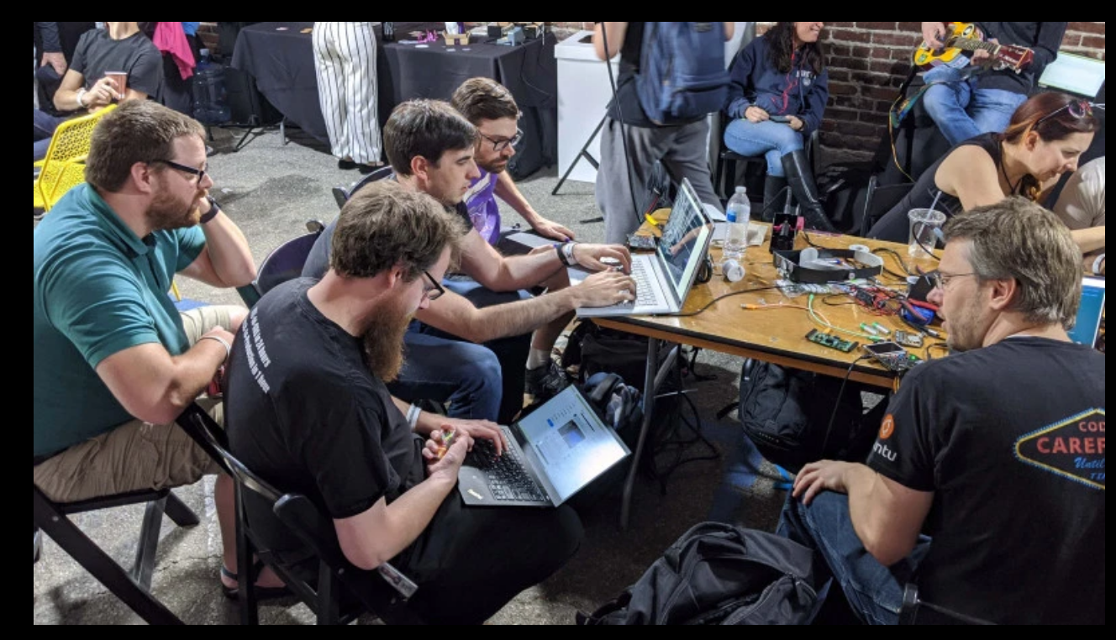
“Team Linux on Badge”

Slide 44
“Team Linux on Badge”
Blog post: Hackaday Supercon badge boots Linux using SDRAM cartridge
https://blog.oshpark.com/2019/12/20/boot-linux-on-this-hackaday-supercon-badge-with-this-sdram-cartridge/
Michael Welling (@QwertyEmedded), Tim Ansell (@mithro), Sean Cross (@xobs), Jacob Creedon (@jacobcreedon)
First attempt: use the built-in 16MB SRAM… no luck :(
(though xobs now might have a way to do it)

Slide 45
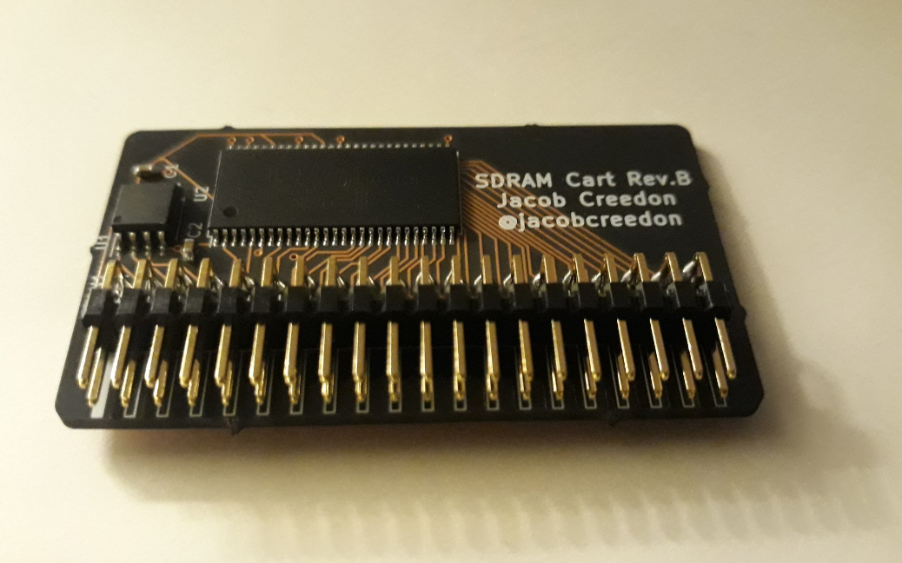
“Team Linux on Badge”
Second attempt:
Jacob Creedon designed an a cartridge board that adds 32MB of SDRAM to the Hackaday Supercon badge… before the event!

Slide 46
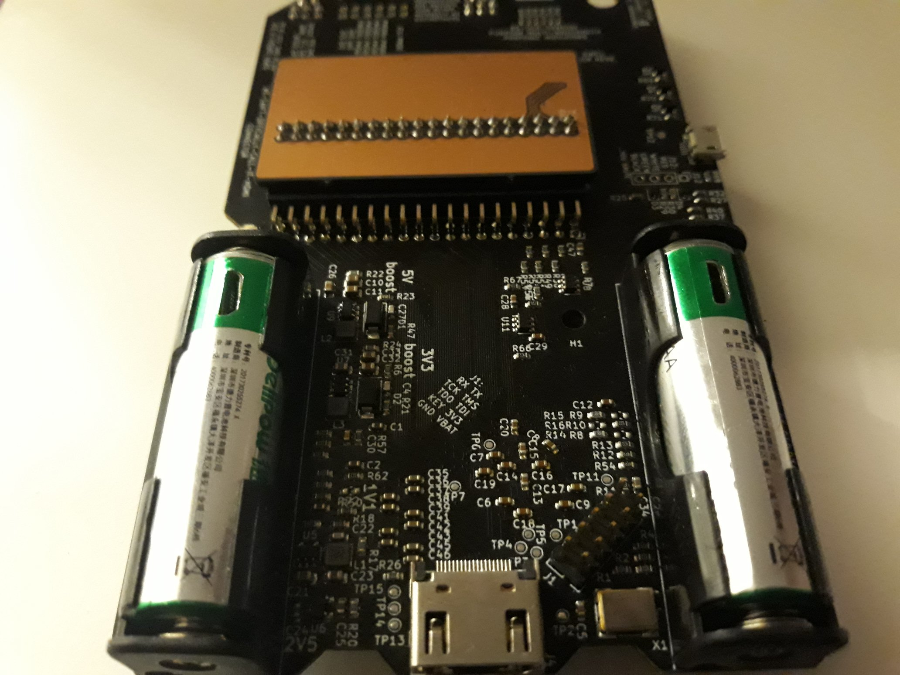
“Team Linux on Badge”
Second attempt:
Jacob Creedon designed an a cartridge board that adds 32MB of SDRAM to the Hackaday Supercon badge… before the event!

Slide 47
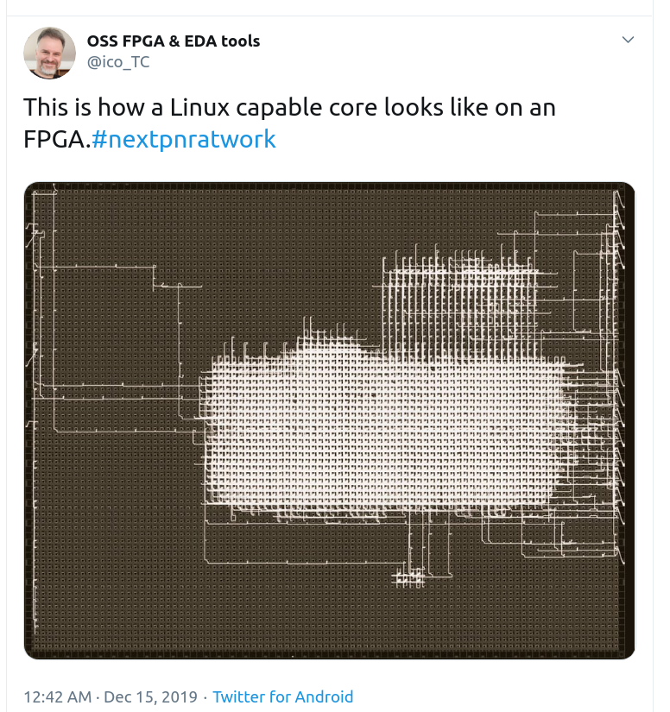

Slide 48
Designing Hardware in Python?
Yes!
“Using Python for creating hardware to record FOSS conferences!”
Tim “mithro” Ansell
youtube.com/watch?v=MkVX_mh5dOU

Slide 49
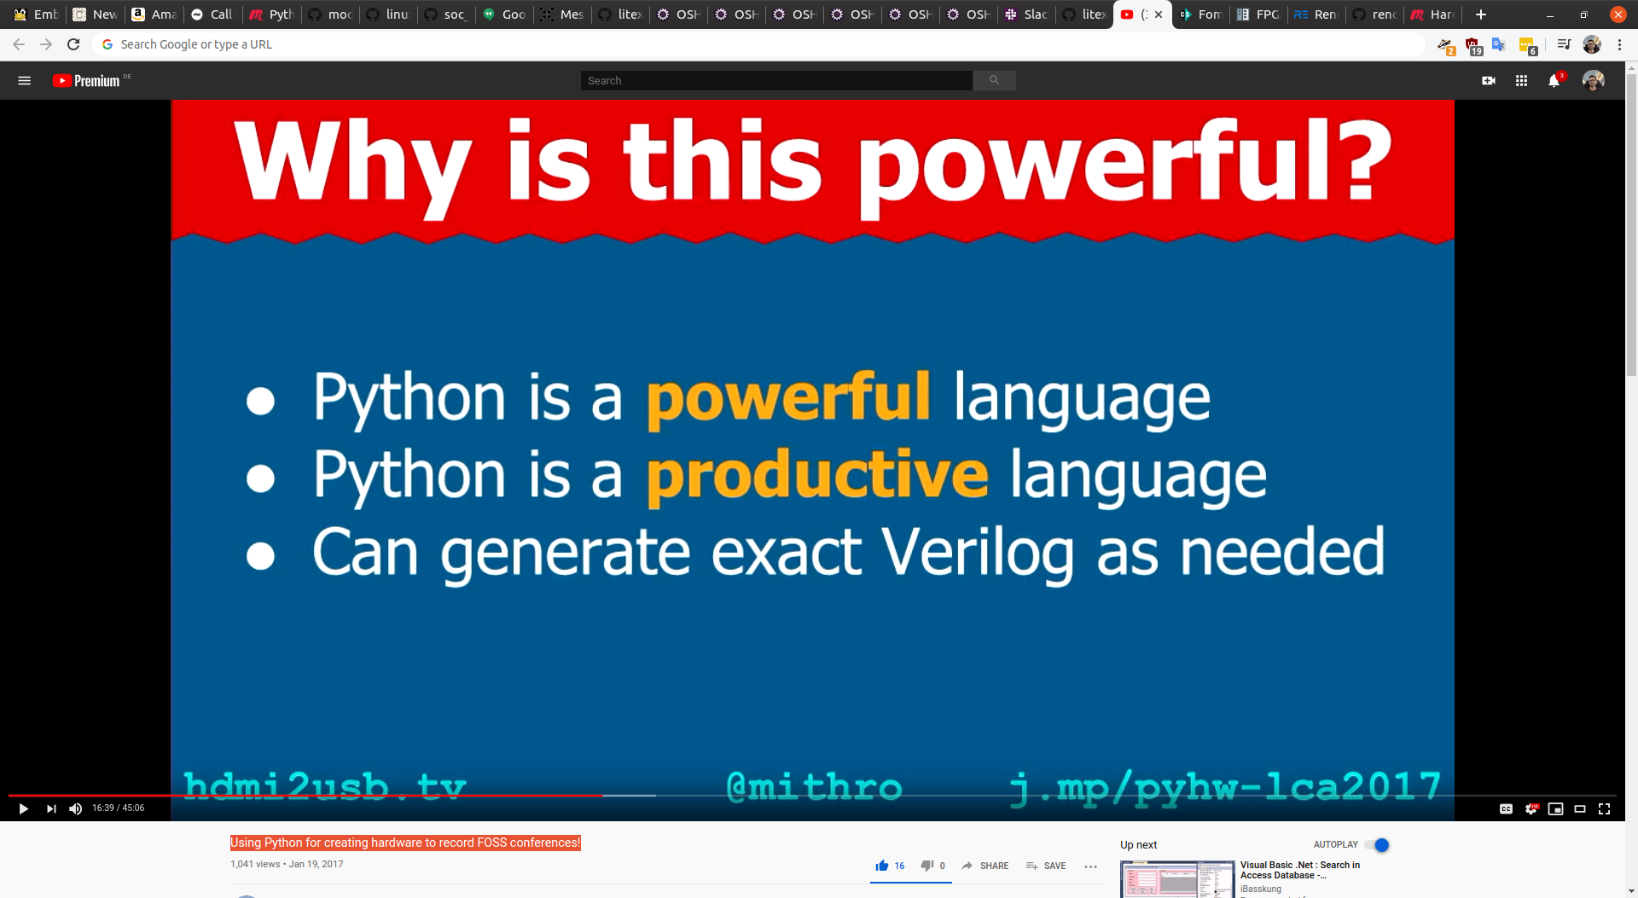

Slide 50
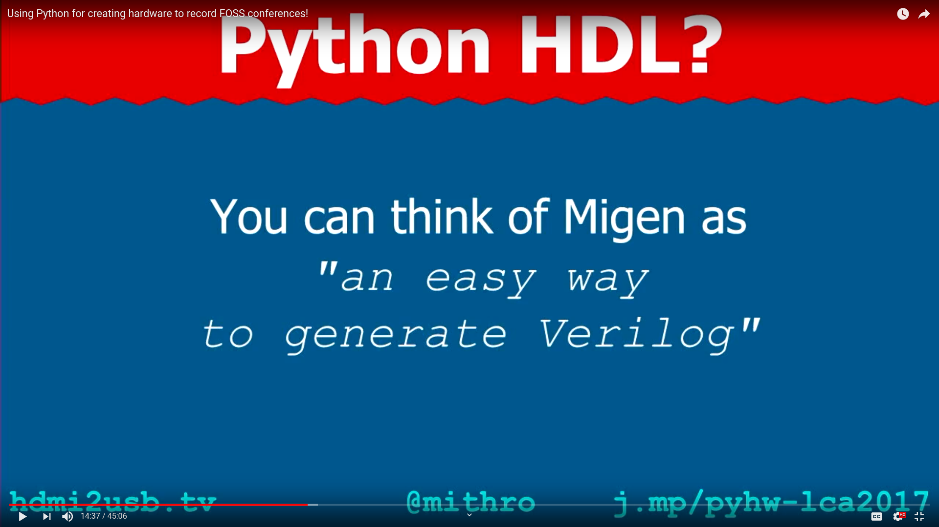

Slide 51
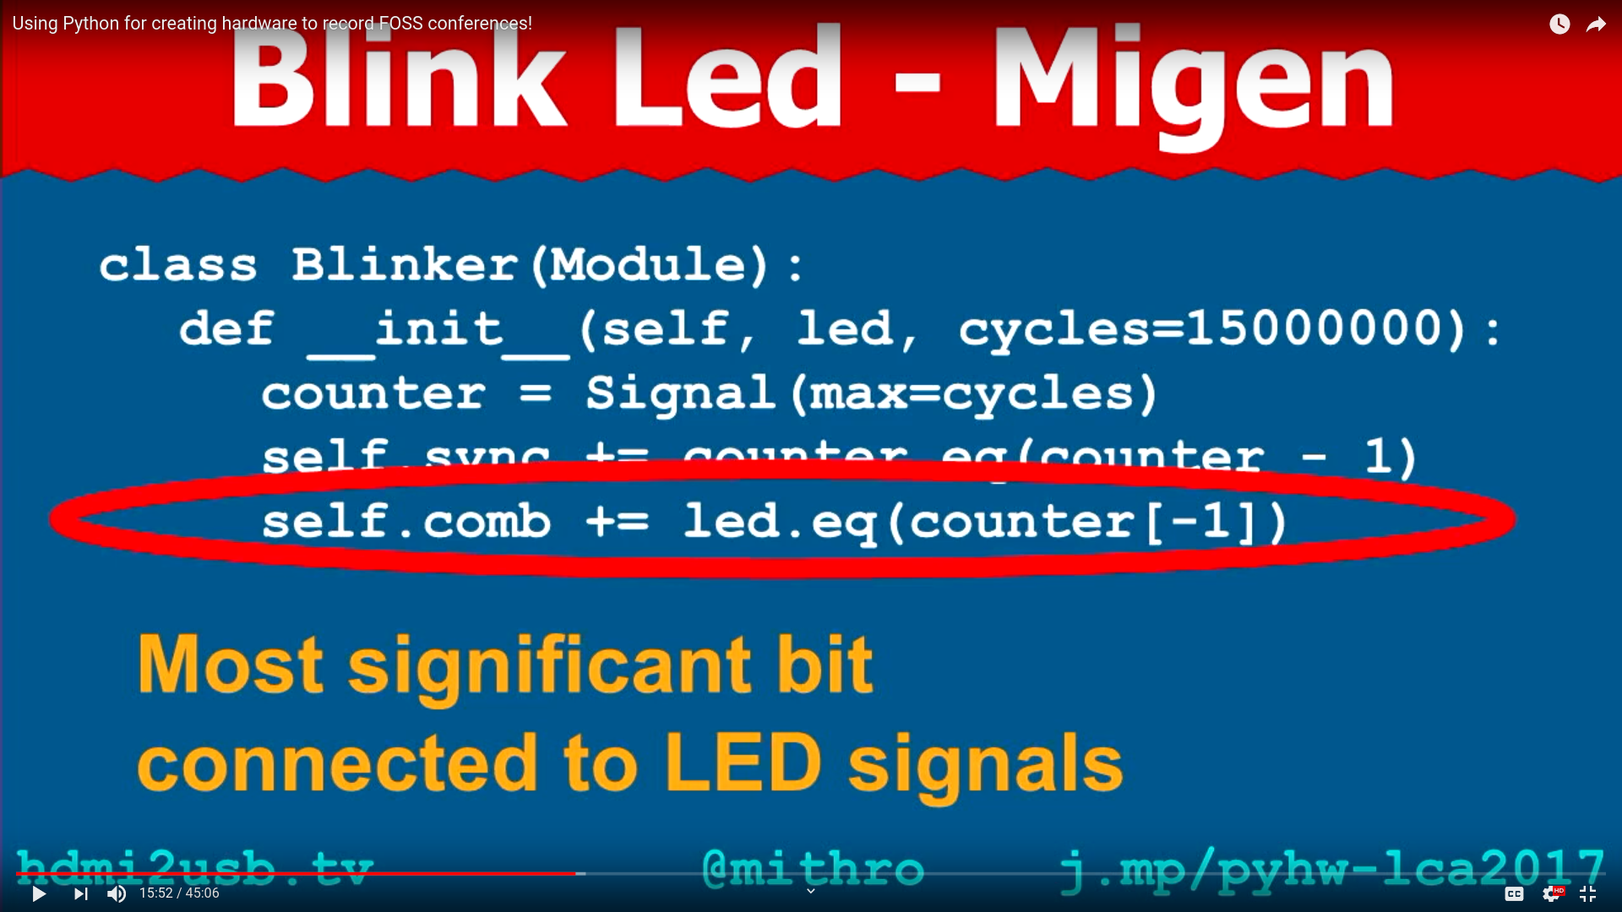

Slide 52
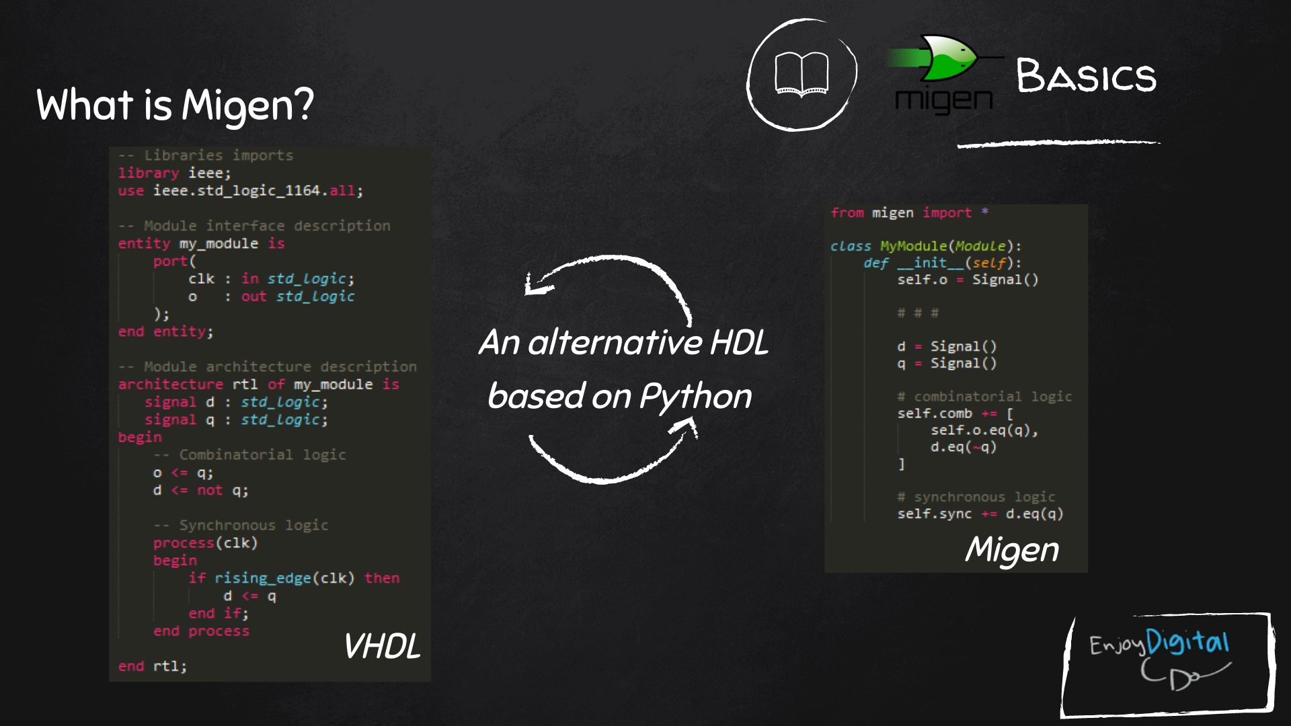
Slides: https://github.com/litex-hub/fpga_101

Slide 53
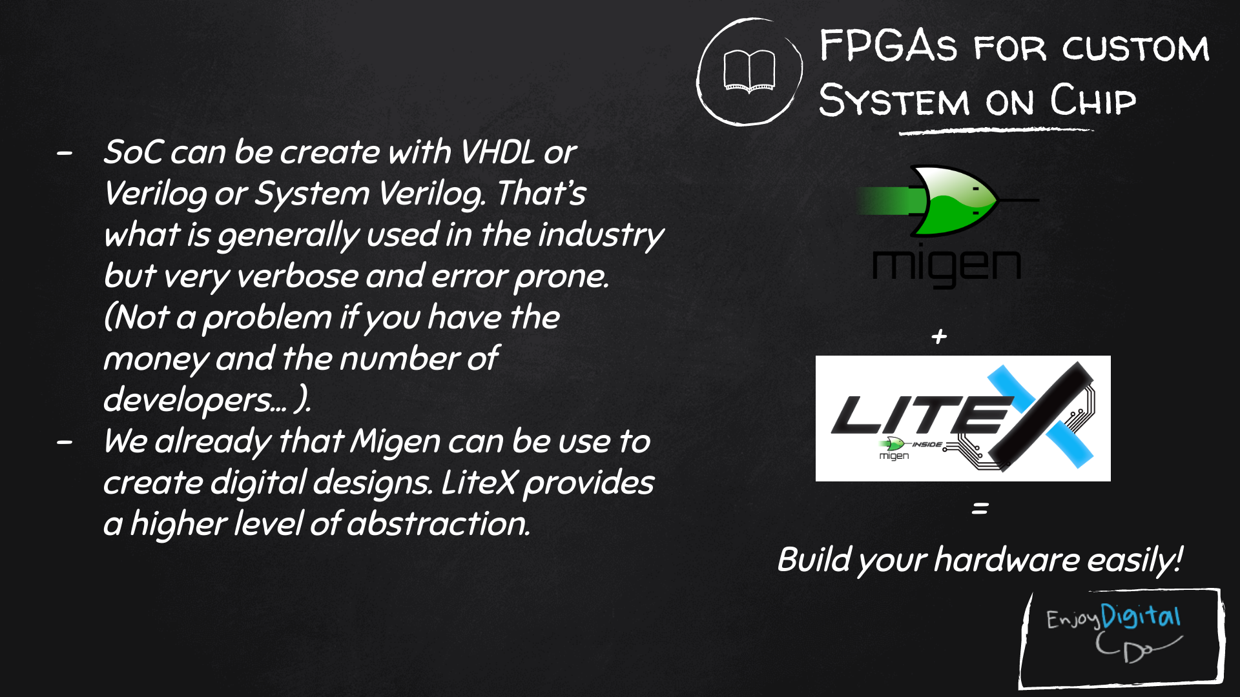
Slides: https://github.com/litex-hub/fpga_101

Slide 54

LiteX used to build cores, create SoCs and full FPGA designs.
LiteX is based on Migen
Migen lets you do FPGA design in Python!
https://github.com/enjoy-digital/litex

Slide 55
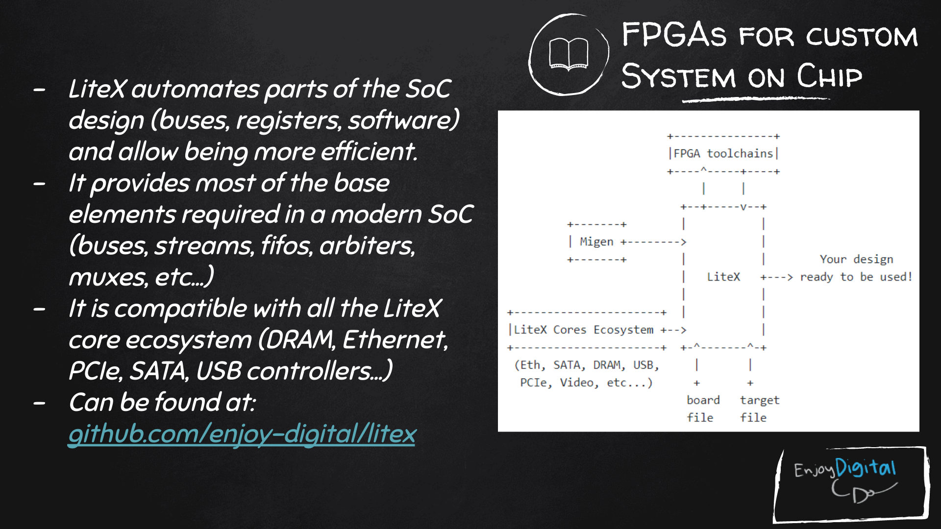
Slides: https://github.com/litex-hub/fpga_101
https://github.com/litex-hub/fpga_101

Slide 56
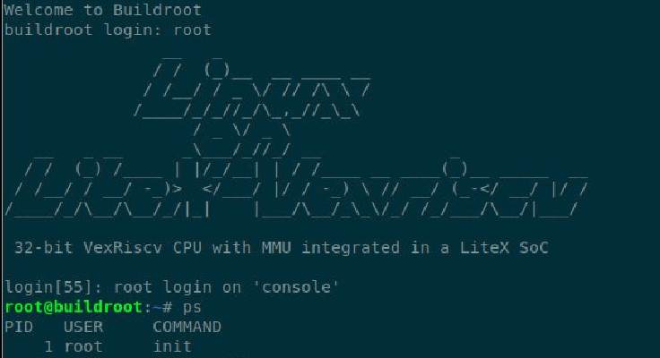
Linux on LiteX-VexRiscv
VexRiscv: 32-bit Linux Capable RISC-V CPU
SoC built using VexRiscv core and LiteX moduels like LiteDRAM, LiteEth, LiteSDCard, ...
github.com/litex-hub/linux-on-litex-vexriscv

Slide 57
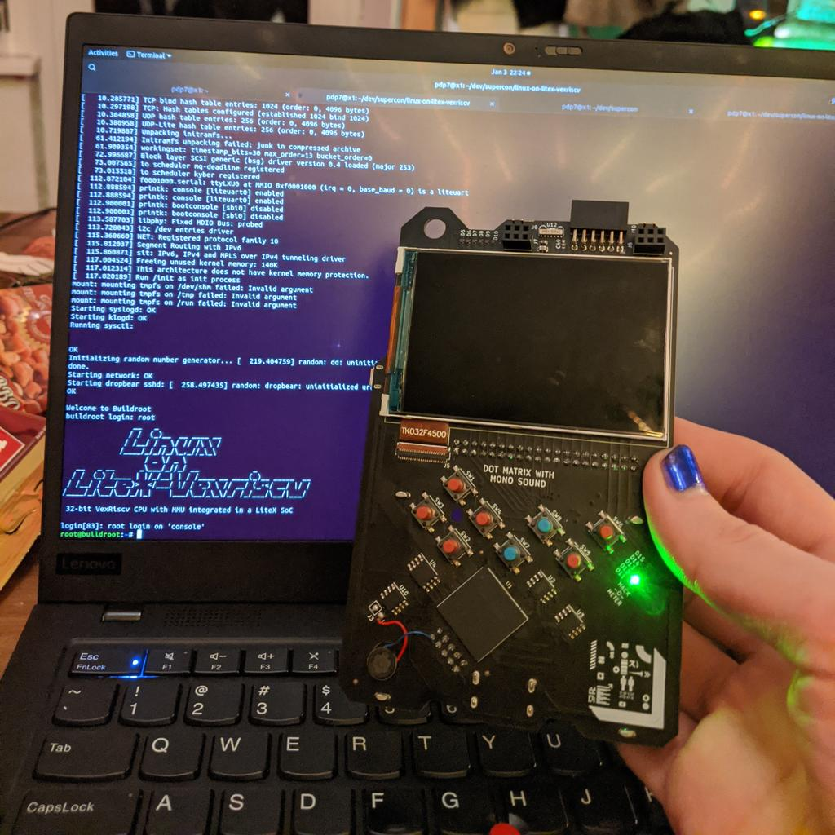

Slide 58
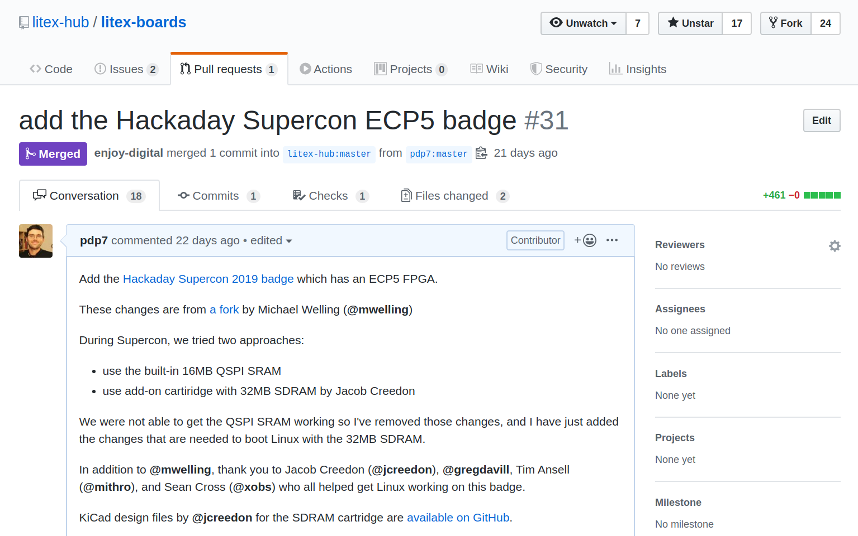
upstream support for Hackaday Supercon badge:
https://github.com/litex-hub/litex-boards/pull/31

Slide 59
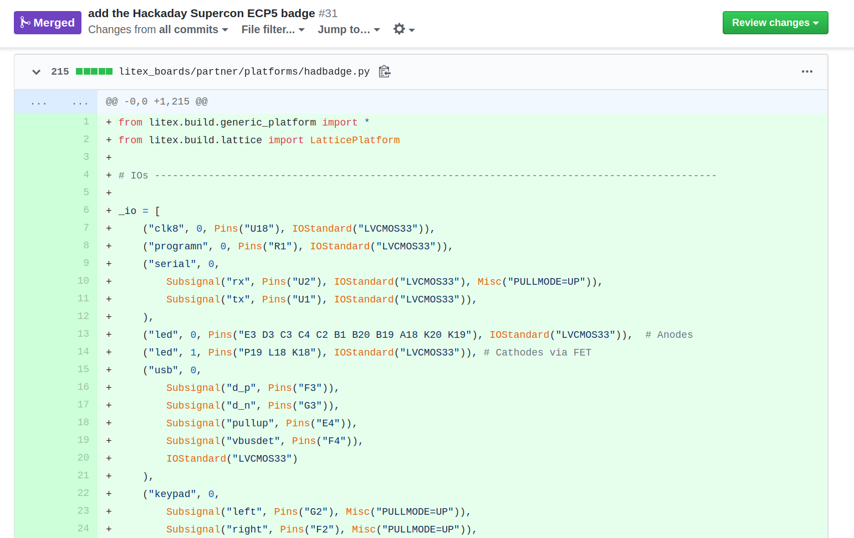
upstream support for Hackaday Supercon badge:
https://github.com/litex-hub/litex-boards/pull/31

Slide 60
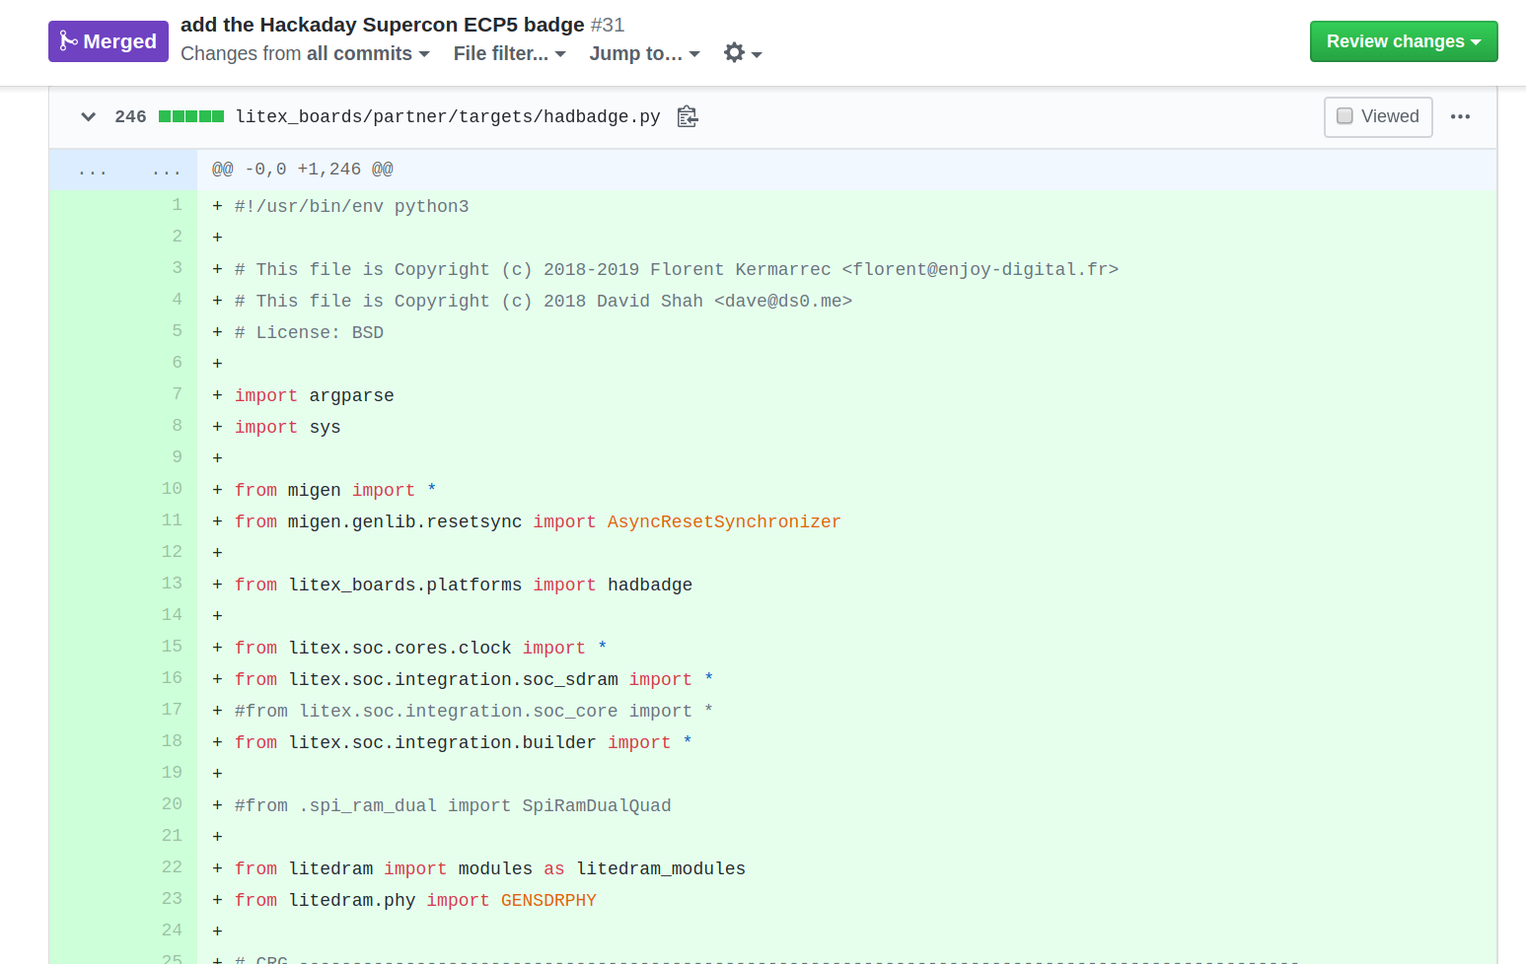
upstream support for Hackaday Supercon badge:
https://github.com/litex-hub/litex-boards/pull/31

Slide 61
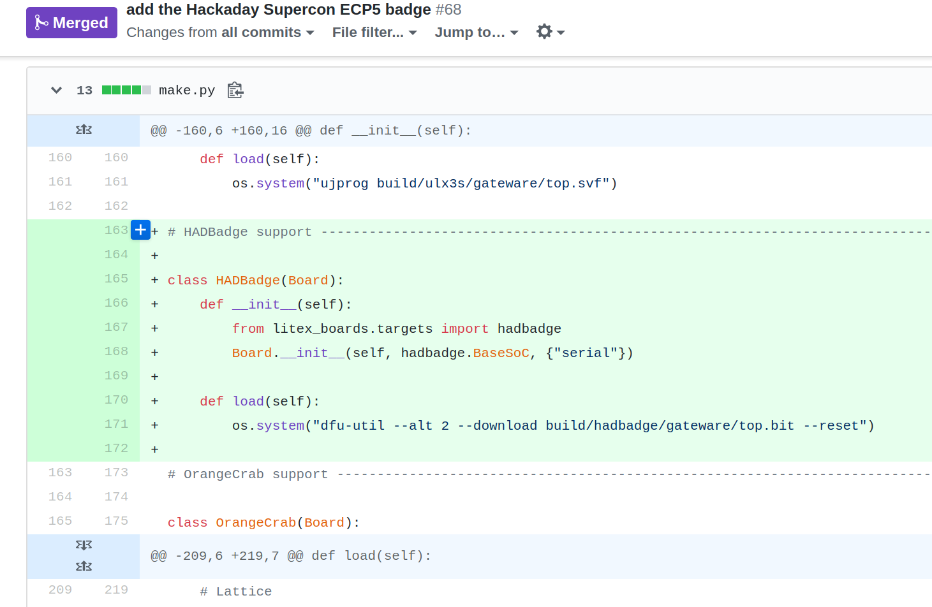

Slide 62
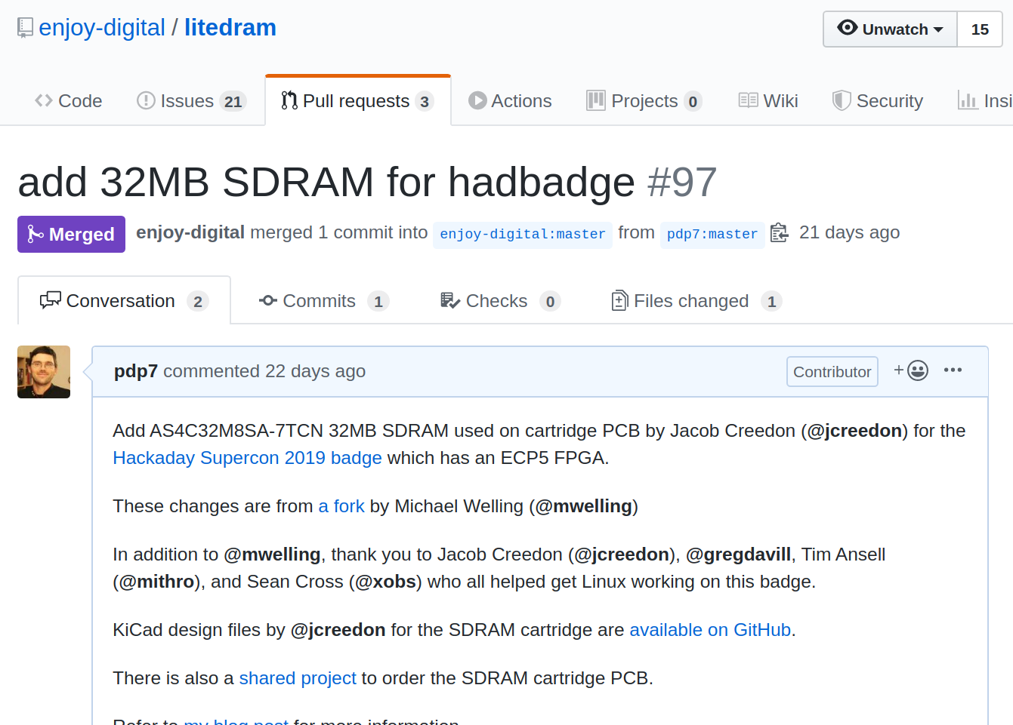

Slide 63
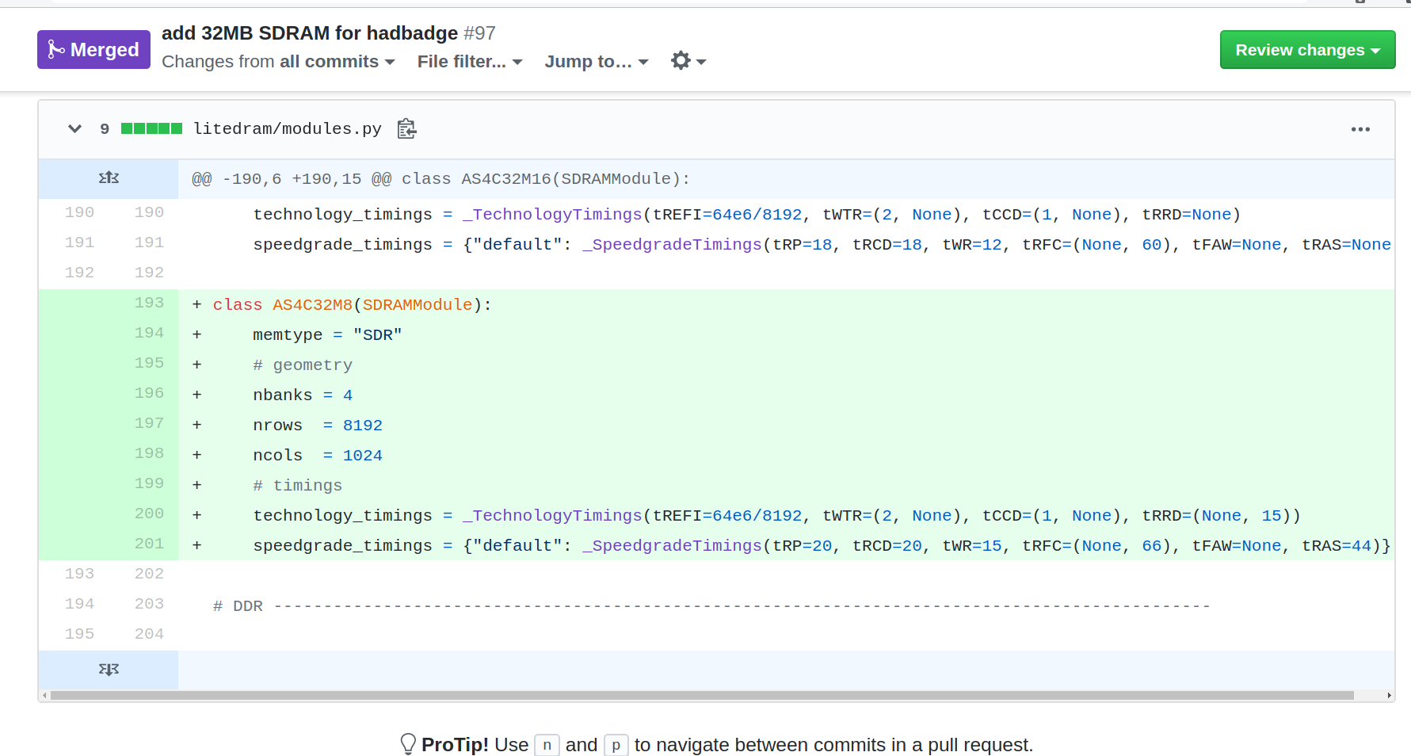

Slide 64
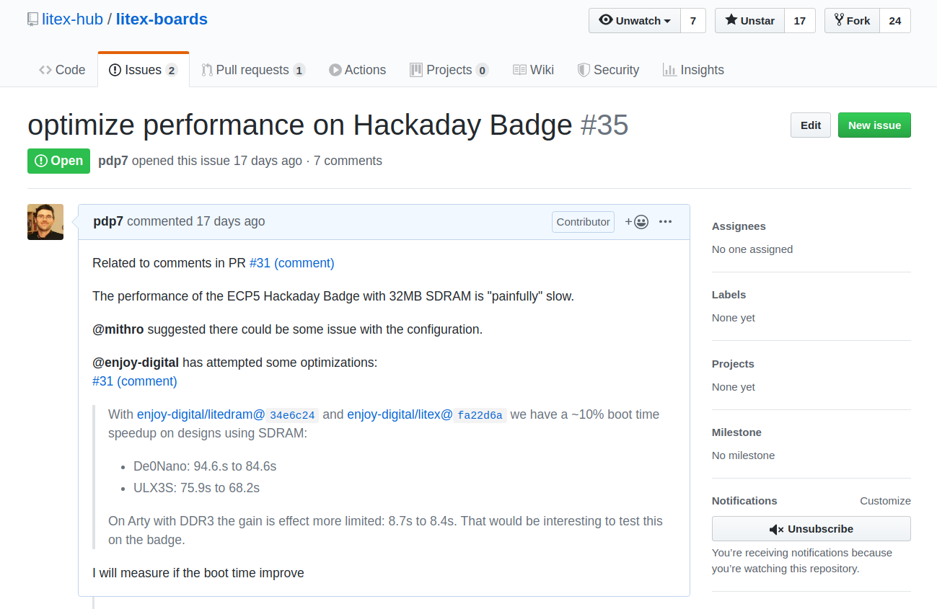

Slide 65
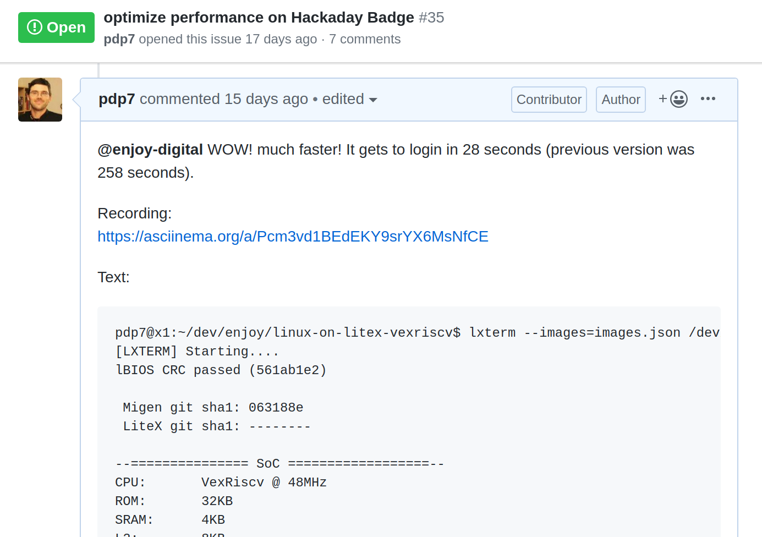

Slide 66
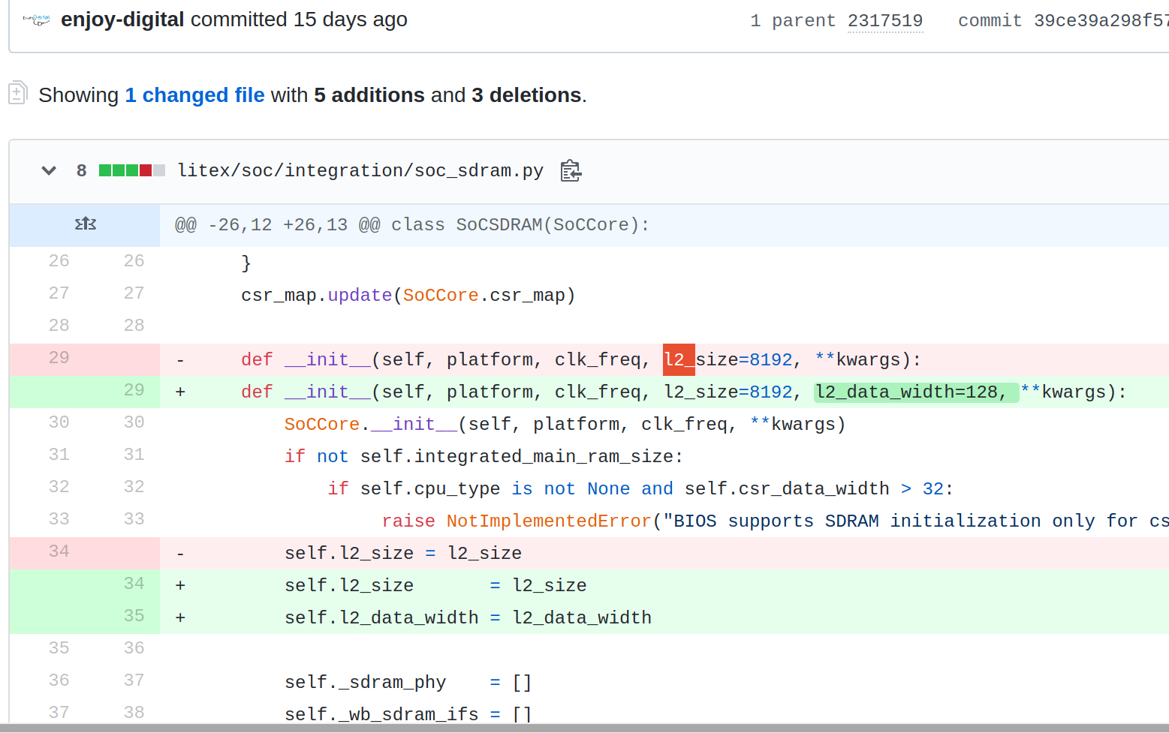

Slide 67

Greg Davill got the screen working with LiteVideo!
twitter.com/GregDavill/status/1231082623633543168

Slide 68
Open Source boards with ECP5 FPGA (can run Linux)
Slides: https://github.com/pdp7/talks/blob/master/rv-elc.pdf

Slide 69

Open Source ECP5 boards
Radiona.org ULX3S
https://www.crowdsupply.com/radiona/ulx3s

Slide 70

Open Source ECP5 boards
Lattice ECP5 FPGA in Adafruit Feather form factor and 128MB DDR RAM:
Orange Crab by Greg Davill
https://github.com/gregdavill/OrangeCrab
https://groupgets.com/campaigns/710-orangecrab

Slide 71


Slide 72

Open Source ECP5 boards
Orange Crab by Greg Davill
https://groupgets.com/campaigns/710-orangecrab

Slide 73

Want to learn FPGAs? Try Fomu!
workshop.fomu.im
crowdsupply.com/sutajio-kosagi/fomu
Fits in USB port
RGB LED
Learn:
MicroPython
Verilog
LiteX

Slide 74

No hardware? Try Renode!
https://renode.io/

Slide 75

No hardware? Try Renode!
https://renode.io/

Slide 76


Slide 77


Slide 78

Become a
Slides:
github.com/pdp7/talks/blob/master/rv-elc.pdf
Contact: @pdp7 || drew@oshpark.com
36c3 talk

